Slide 1
Advanced CSS: Layout
Chapter 5

Slide 2
Objectives
1
2
Normal Flow
Positioning
Elements
3
4
Floating Elements
Multicolumn Layouts
5
6
Approaches to CSS Layout
Responsive Design
7
7
CSS Frameworks

Slide 3
Normal Flow
Section 1 of 7

Slide 4
Normal Flow
If it’s so normal why have I never heard of it?
Normal flow refers here to how the browser will normally display block-level elements and inline elements from left to right and from top to bottom
Block-level elements are each contained on their own line
<p>, <div>, <h2>, <ul>, and <table>
Inline elements do not form their own blocks but instead are displayed within lines
as <em>, <a>, <img>, and <span>

Slide 5
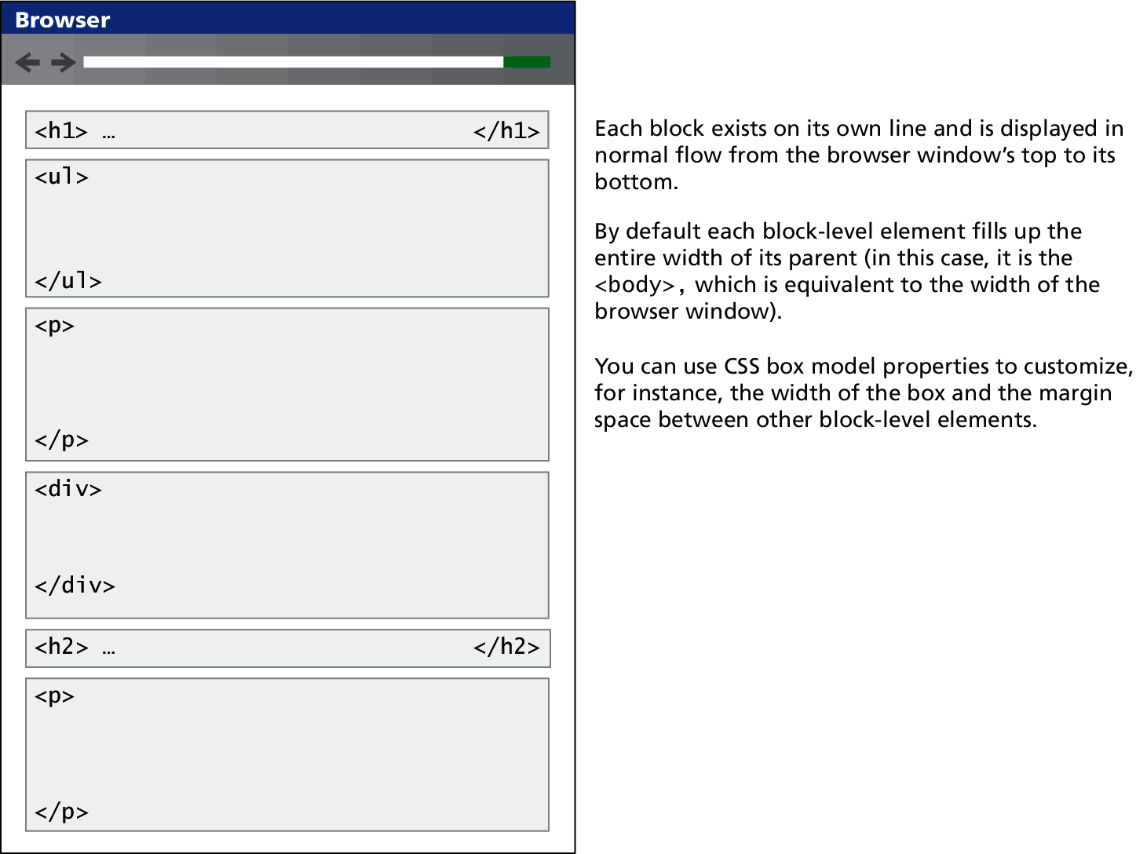
Normal Flow
Example

Slide 6
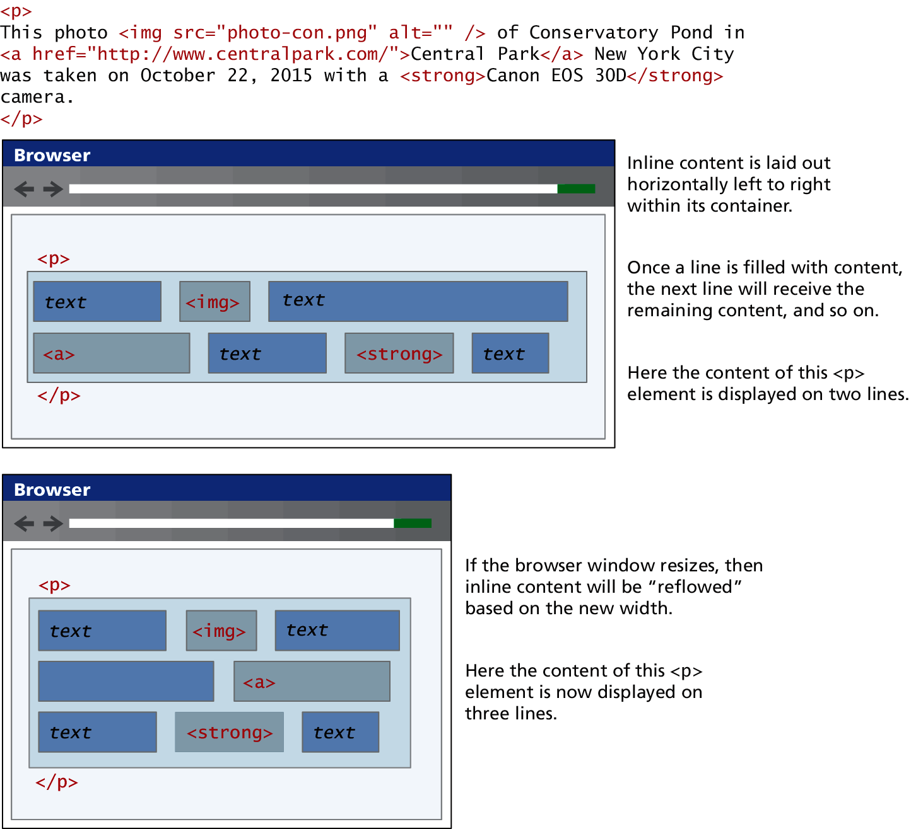
Normal Flow
Example

Slide 7
Inline Elements
There are actually two types of inline elements: replaced and nonreplaced.
Replaced inline elements are elements whose content and thus appearance is defined by some external resource, such as <img> and the various form elements.
Nonreplaced inline elements are those elements whose content is defined within the document, which includes all the other inline elements.

Slide 8
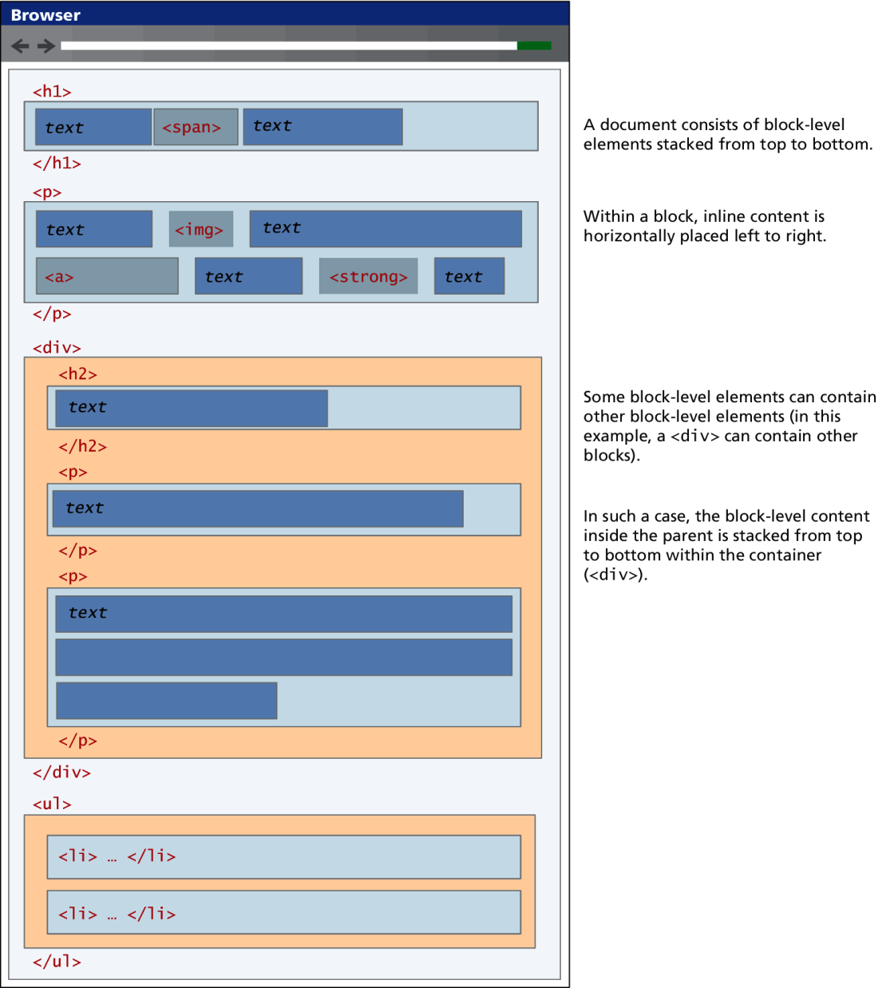
Working Together

Slide 9
Take control
It is possible to change whether an element is block-level or inline via the CSS display property. Consider the following two CSS rules:
span { display: block; }
li { display: inline; }
These two rules will make all <span> elements behave like block-level elements and all <li> elements like inline (that is, each list item will be displayed on the same line).

Slide 10
Positioning Elements
Section 2 of 7

Slide 11
Positioning Elements
Move it a little left…
It is possible to move an item from its regular position in the normal flow, and
move an item outside of the browser viewport so it is not visible
position it so it is always visible in a fixed position while the rest of the content scrolls.
The position property is used to specify the type of positioning

Slide 12
Positioning
Value | Description
absolute | The element is removed from normal flow and positioned in relation to its nearest positioned ancestor.
fixed | The element is fixed in a specific position in the window even when the document is scrolled.
relative | The element is moved relative to where it would be in the normal flow.
static | The element is positioned according to the normal flow. This is the default.

Slide 13
Relative Positioning
Relative to what
In relative positioning an element is displaced out of its normal flow position and moved relative to where it would have been placed
The other content around the relatively positioned element “remembers” the element’s old position in the flow; thus the space the element would have occupied is preserved

Slide 14
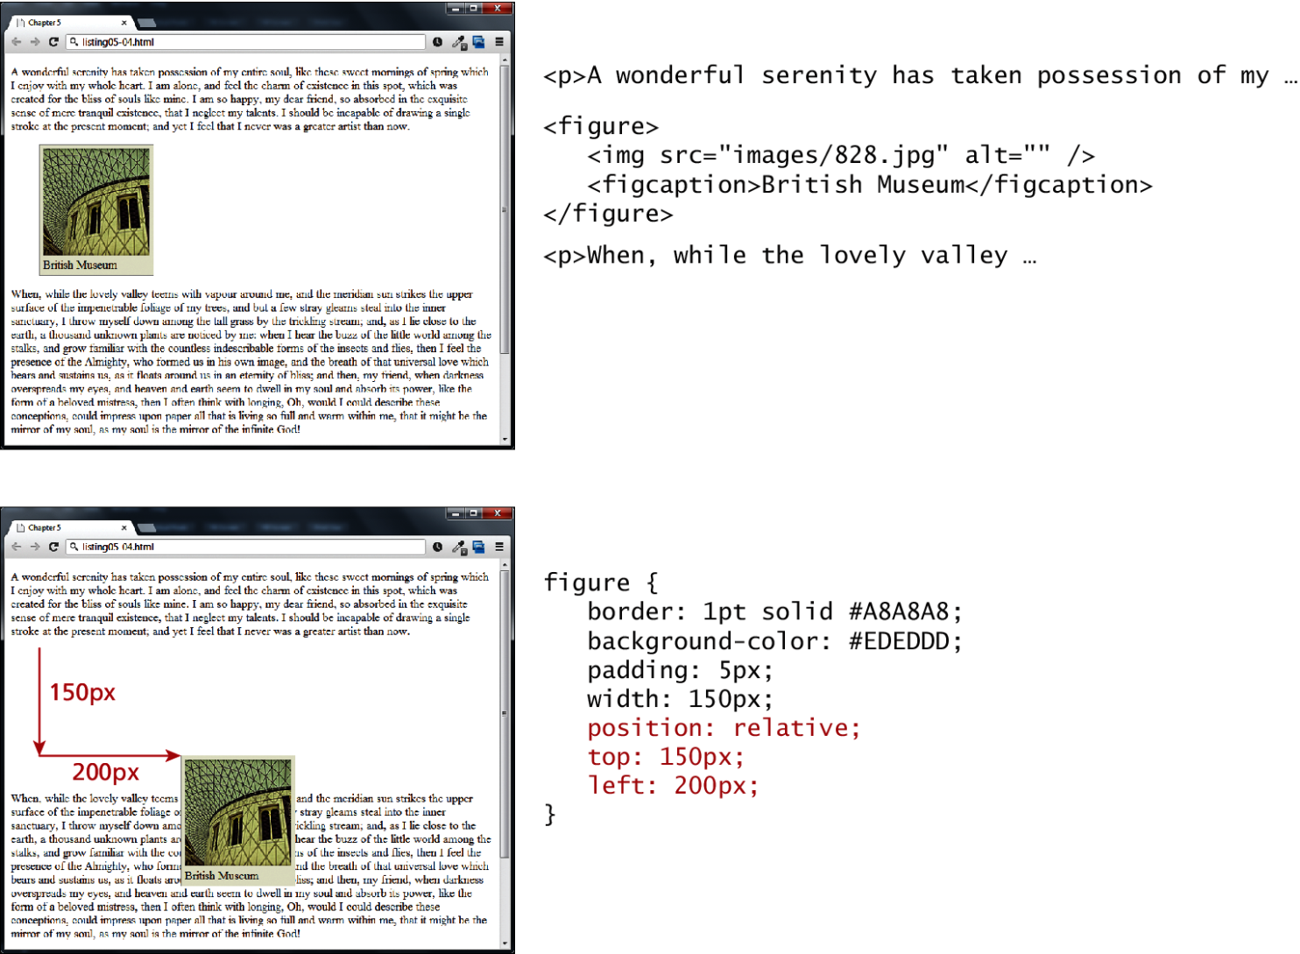
Relative Positioning
Relatively simple Example

Slide 15
Absolute Positioning
Absolutely!
When an element is positioned absolutely, it is removed completely from normal flow.
Unlike with relative positioning, space is not left for the moved element, as it is no longer in the normal flow.
absolute positioning can get confusing

Slide 16
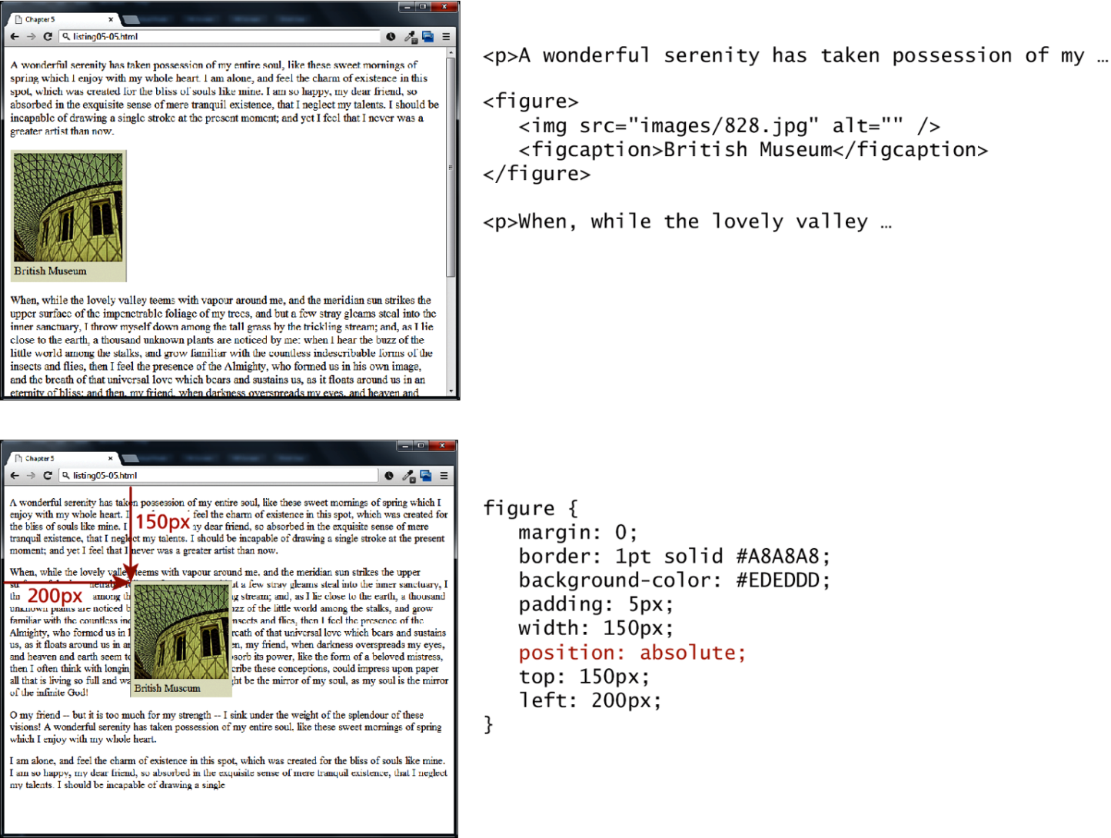
Absolute Positioning
Absolutely great example

Slide 17
Absolute Positioning
Absolutely relative?
A moved element via absolute position is actually positioned relative to its nearest positioned ancestor container

Slide 18
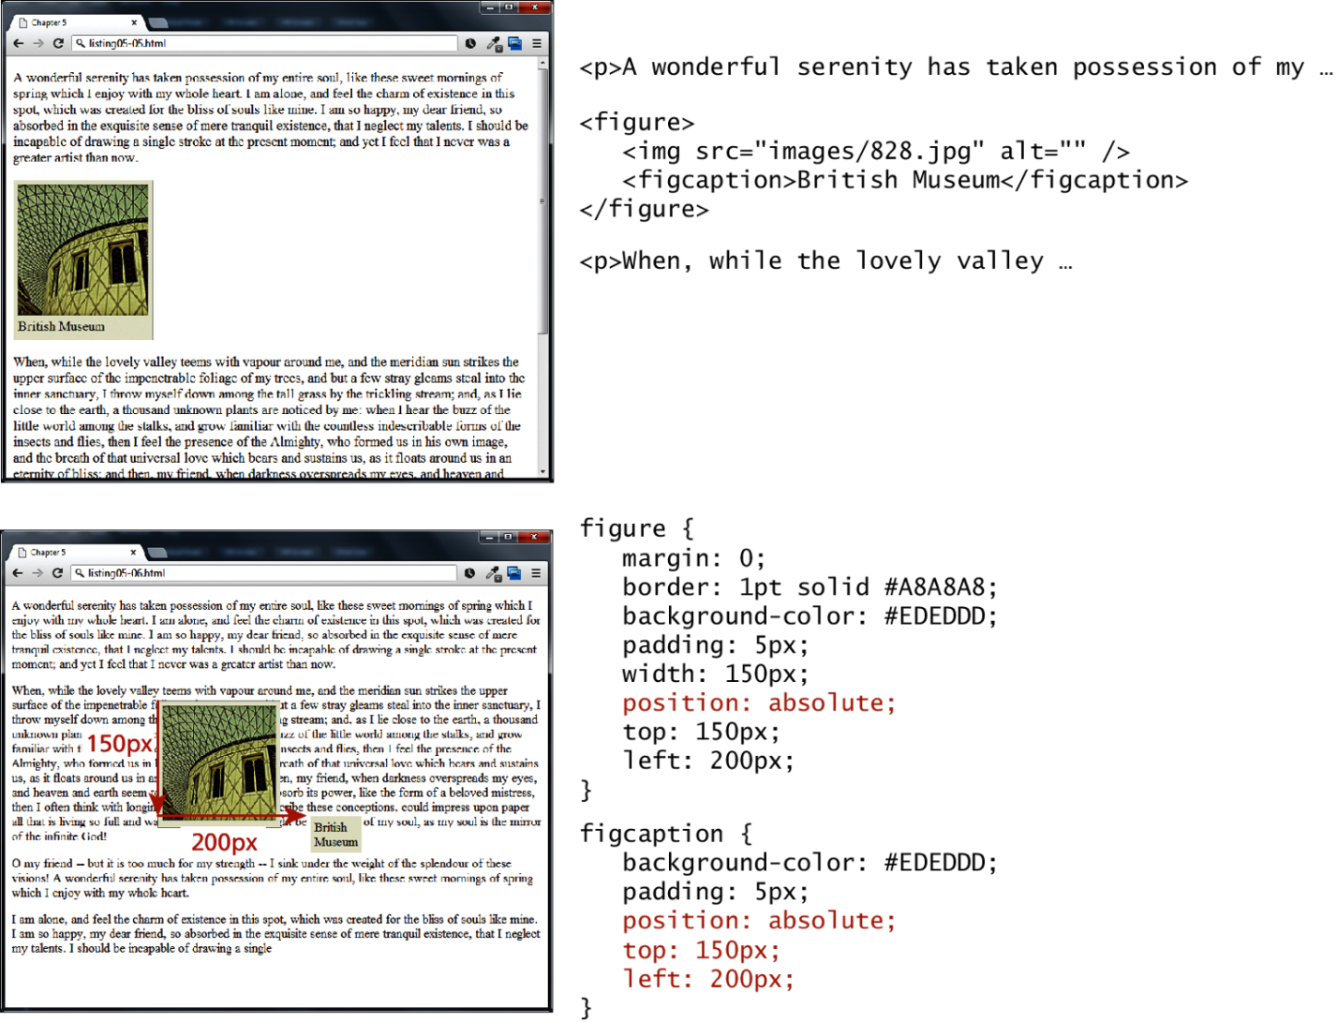
Absolute Positioning

Slide 19
Z-Index
So, like the last topic?
When overlapping elements items closest to the viewer (and thus on the top) have a larger z-index
only positioned elements will make use of their z-index
simply setting the z-index value of elements will not necessarily move them on top or behind other items.

Slide 20
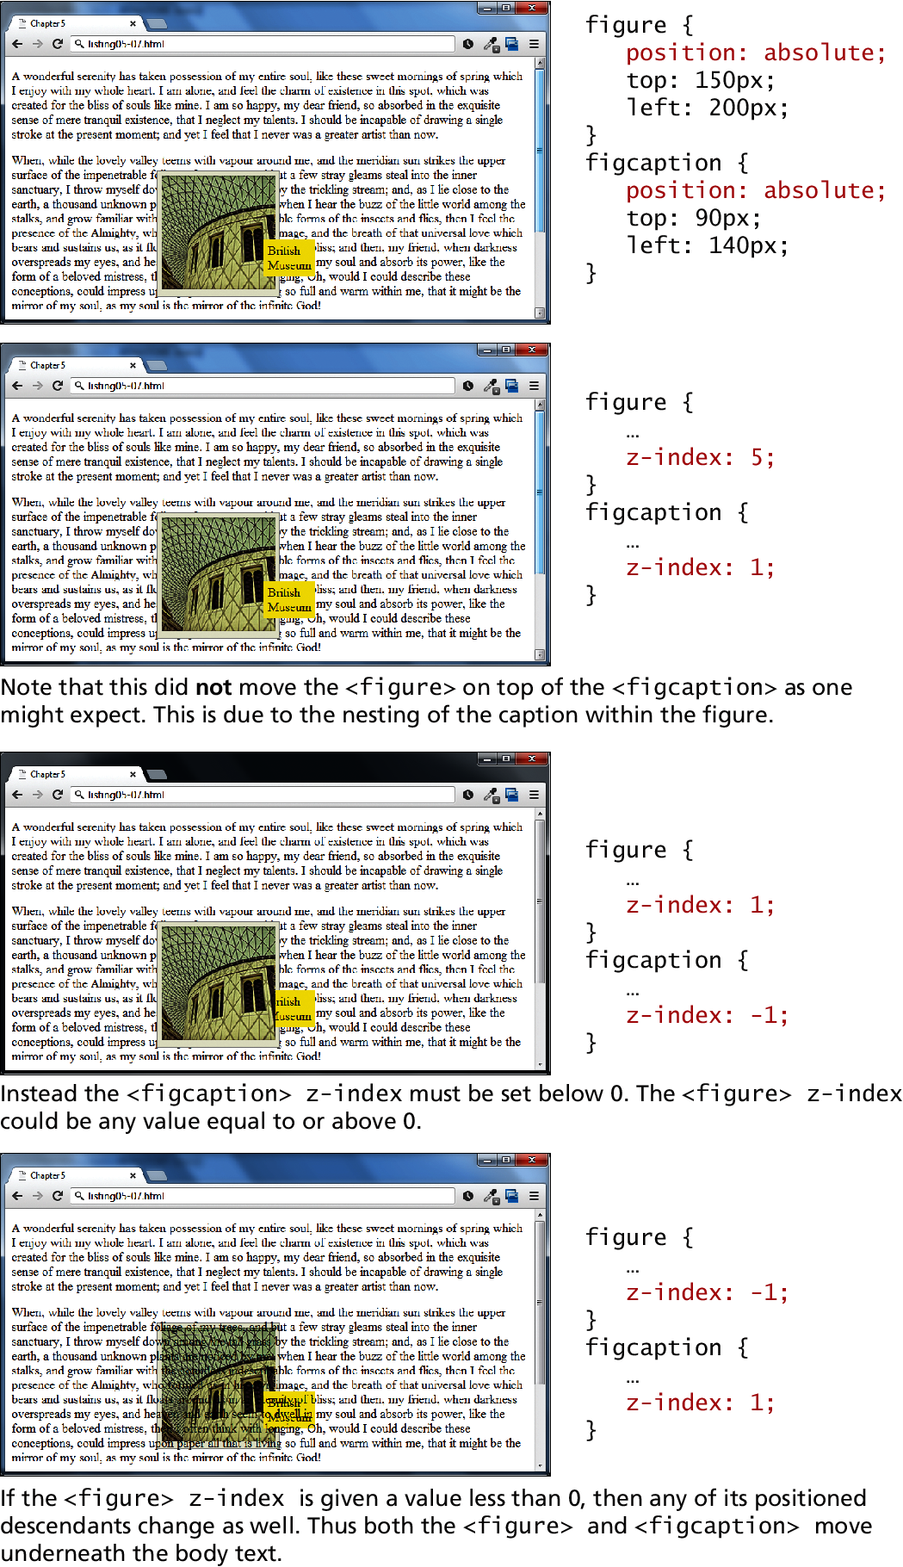
Z-index
Example

Slide 21
Z-index
Example

Slide 22
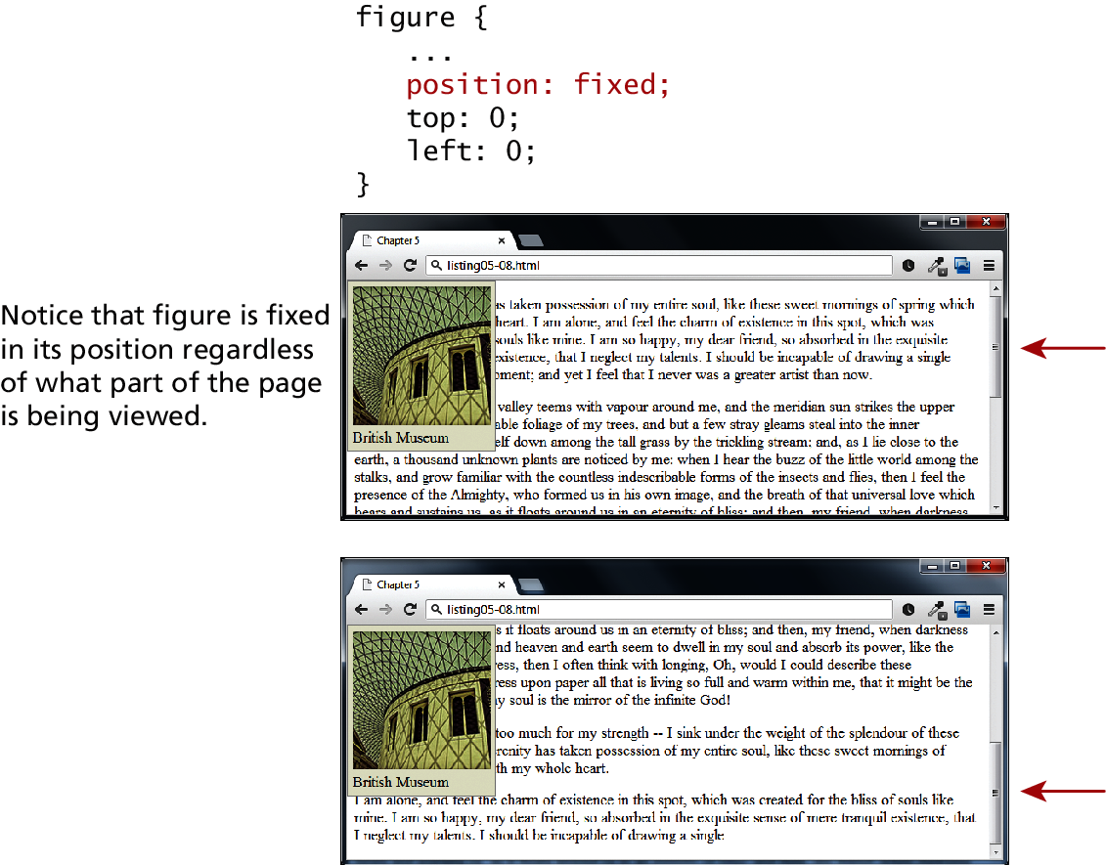
Fixed Position
Place your annoying ads here
Elements with fixed positioning do not move when the user scrolls up or down the page

Slide 23
Floating elements
Section 3 of 7

Slide 24
Floating Elements
It is possible to displace an element out of its position in the normal flow via the CSS float property
An element can be floated to the left or floated to the right
When an item is floated, it is moved all the way to the far left or far right of its containing block and the rest of the content is “re-flowed” around the floated element

Slide 25
Floating Elements
Value | Description
left | The left-hand edge of the element cannot be adjacent to another element.
right | The right-hand edge of the element cannot be adjacent to another element.
both | Both the left-hand and right-hand edges of the element cannot be adjacent to another element.
none | The element can be adjacent to other elements.

Slide 26
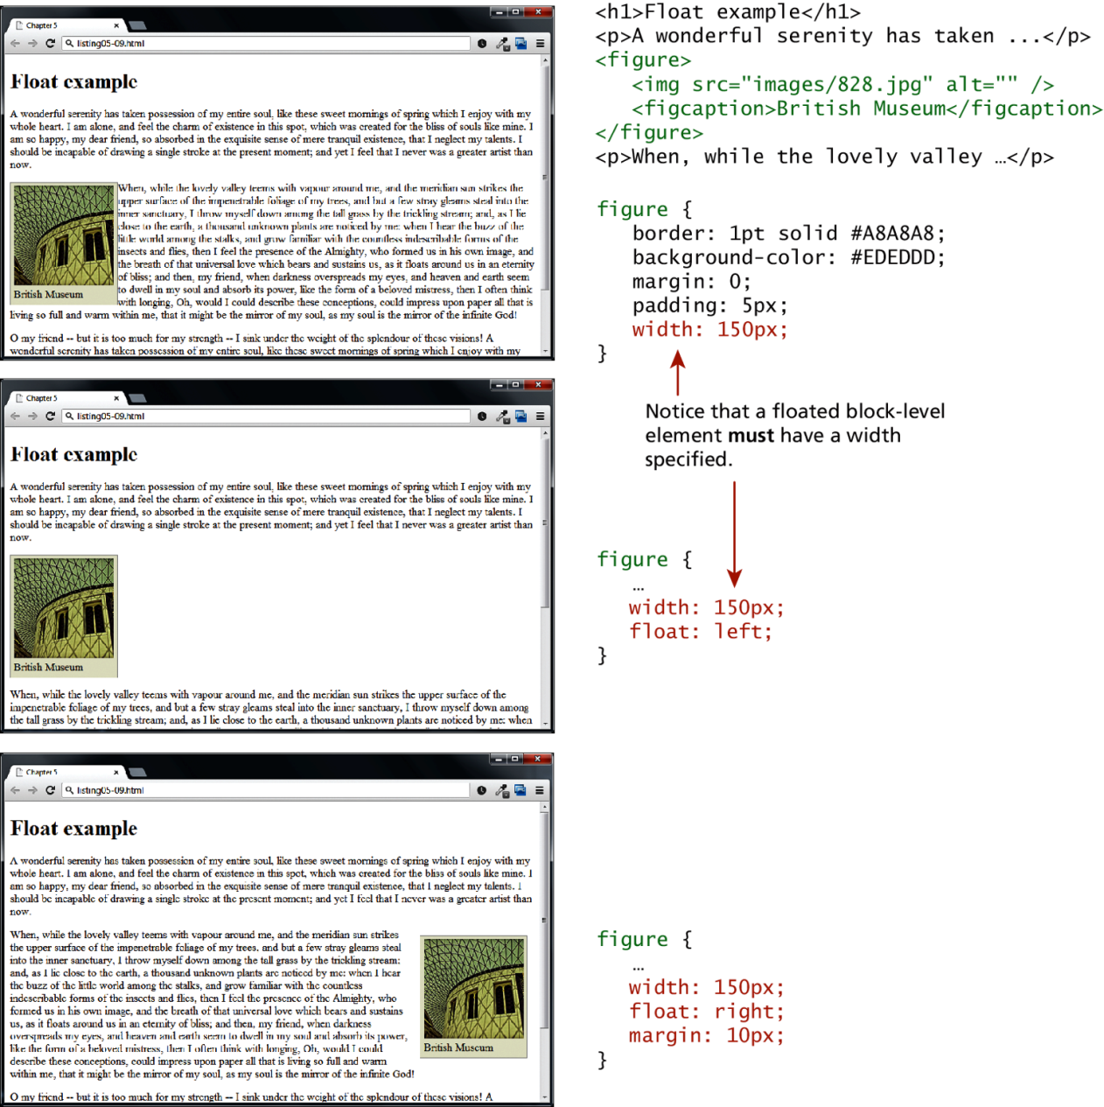
Floating Elements
Example floating

Slide 27
Floating Elements
Details
Notice that a floated block-level element must have a width specified, if you do not, then the width will be set to auto, which will mean it implicitly fills the entire width of the containing block, and there thus will be no room available to flow content around the floated item.

Slide 28
Floating within a container
It should be reiterated that a floated item moves to the left or right of its container (also called its containing block).

Slide 29
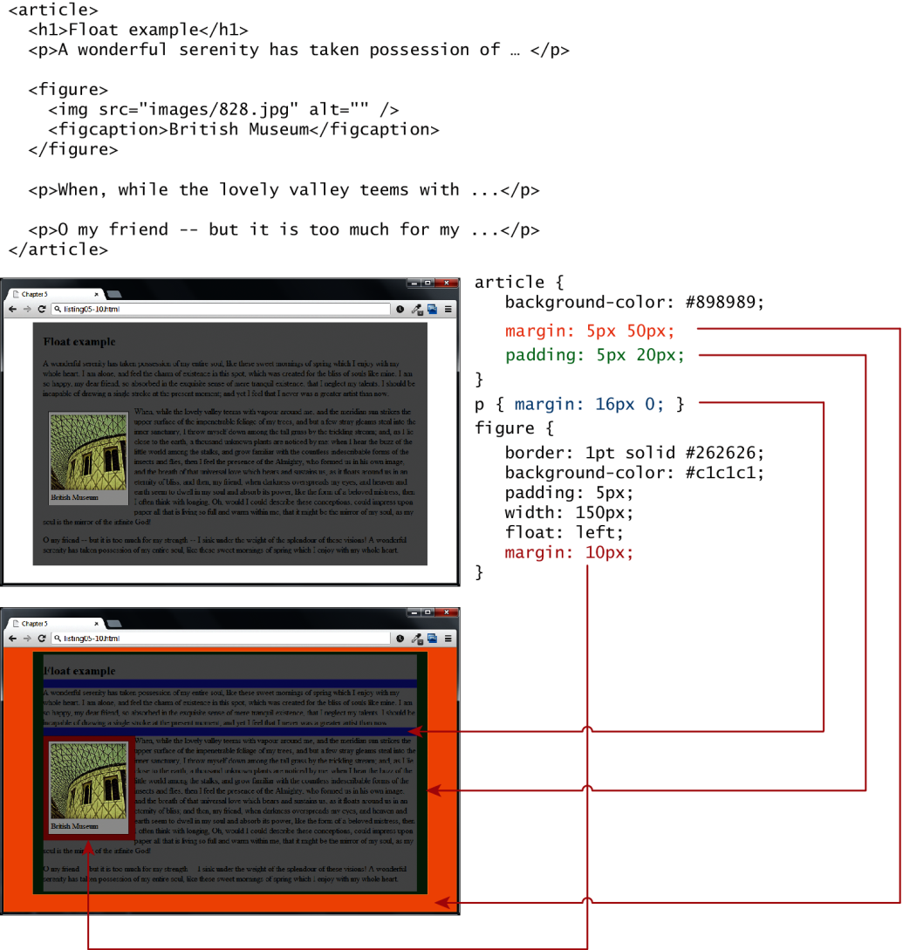
Floating within a container

Slide 30
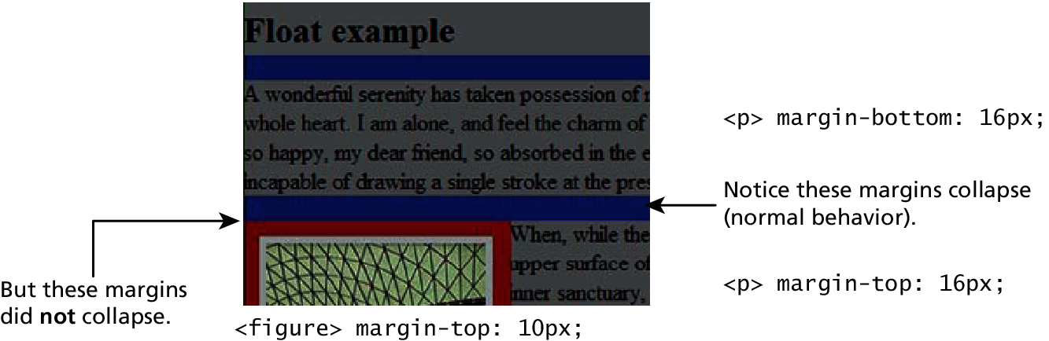
Floating within a container
Zoom

Slide 31
Floating Multiple Items side by side
When you float multiple items that are in proximity, each floated item in the container will be nestled up beside the previously floated item
All other content in the containing block (including other floated elements) will flow around all the floated elements

Slide 32
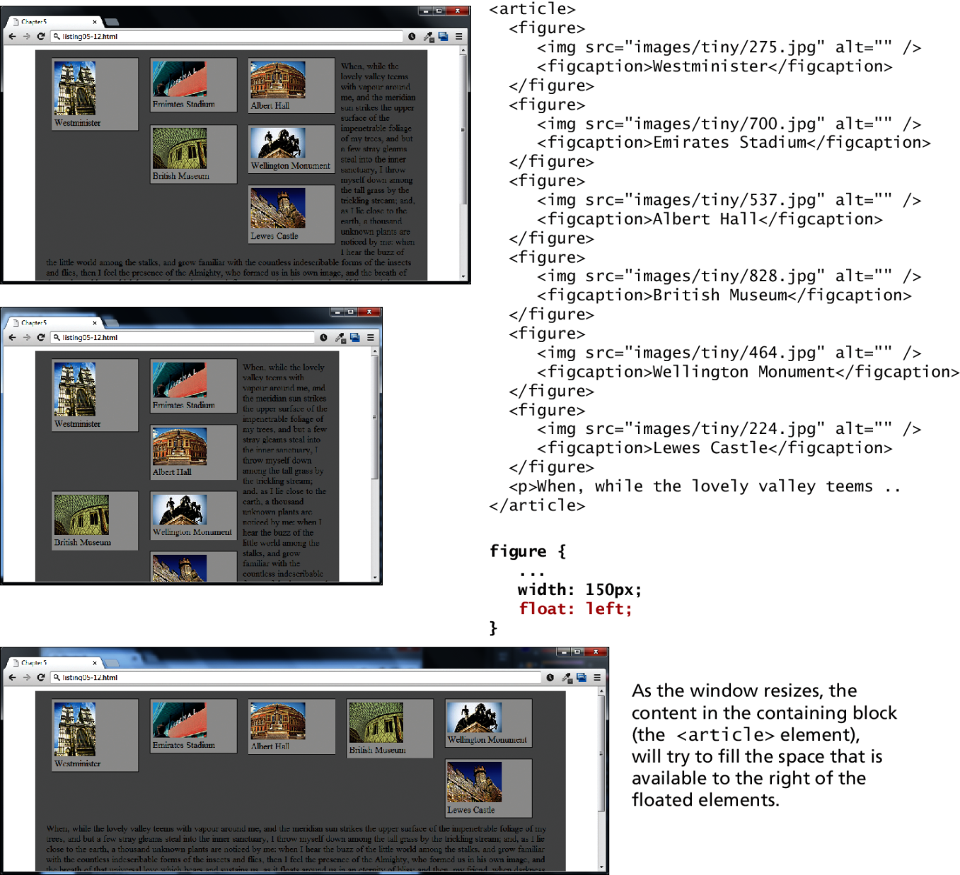
Floating side by side
Example

Slide 33
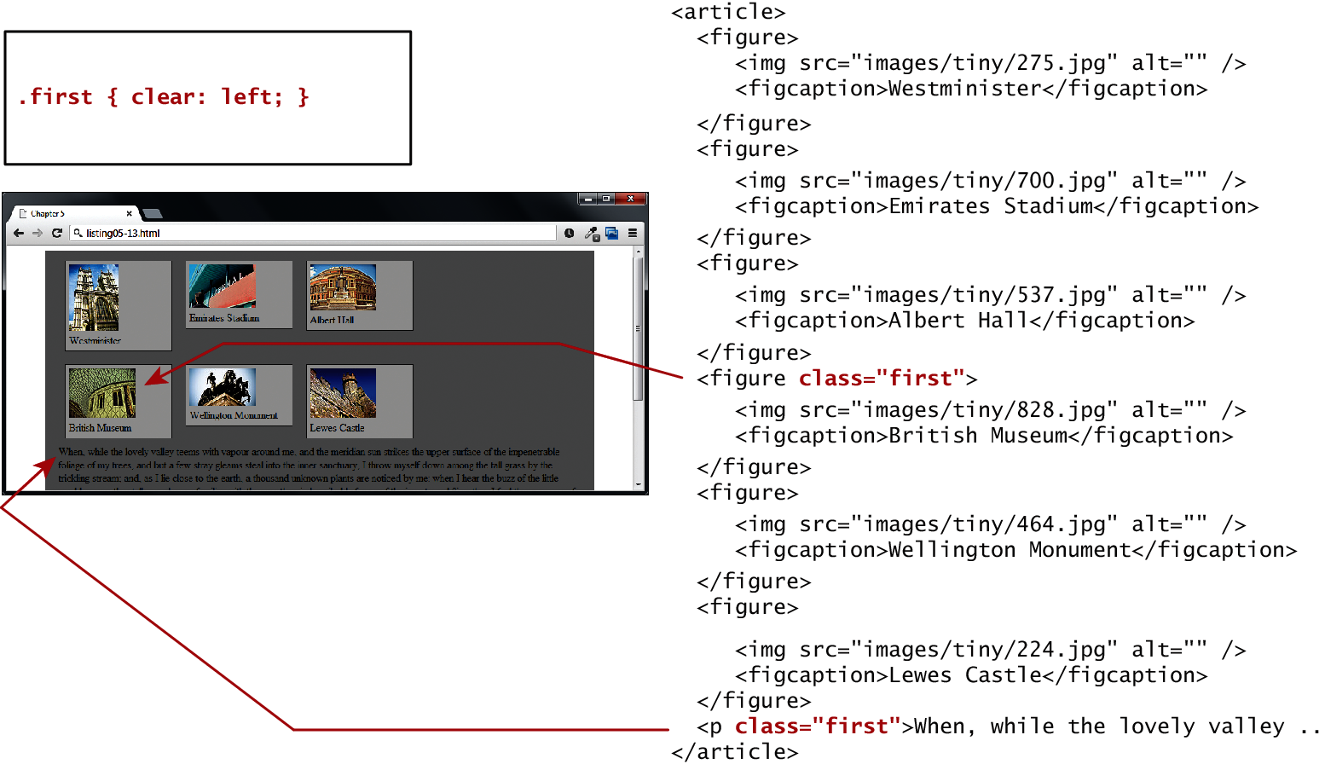
The Clear Property
You can stop elements from flowing around a floated element by using the clear property

Slide 34
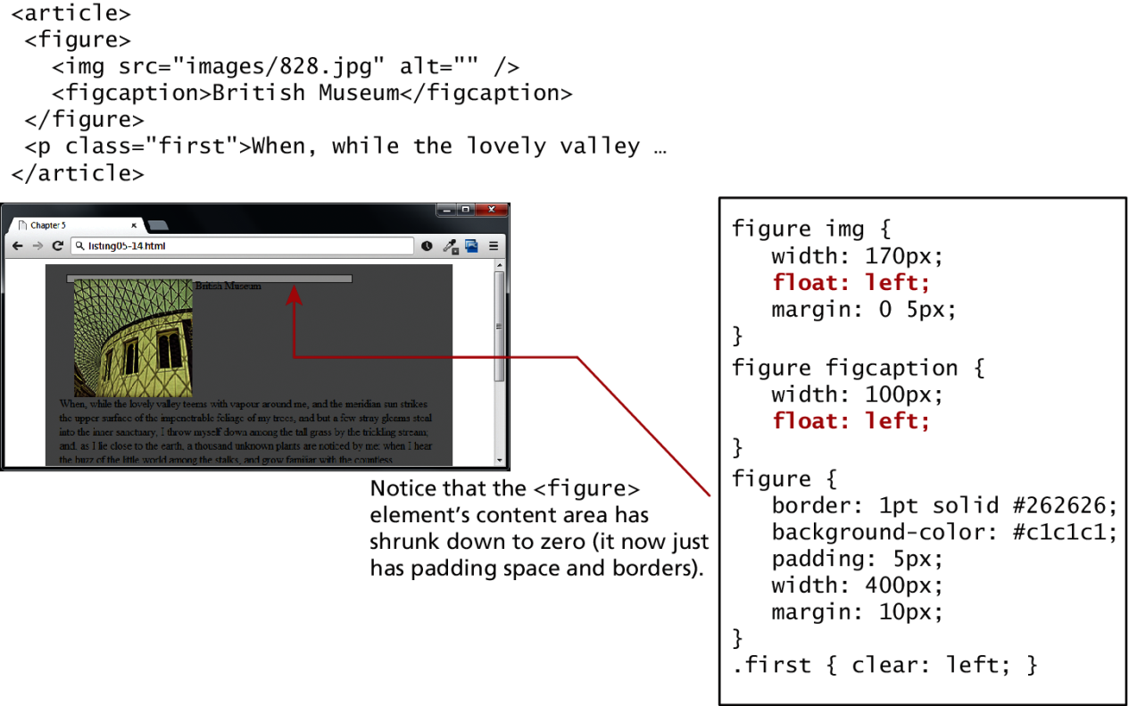
Containing Floats
Problem
Another problem that can occur with floats is when an element is floated within a containing block that contains only floated content. In such a case, the containing block essentially disappears

Slide 35
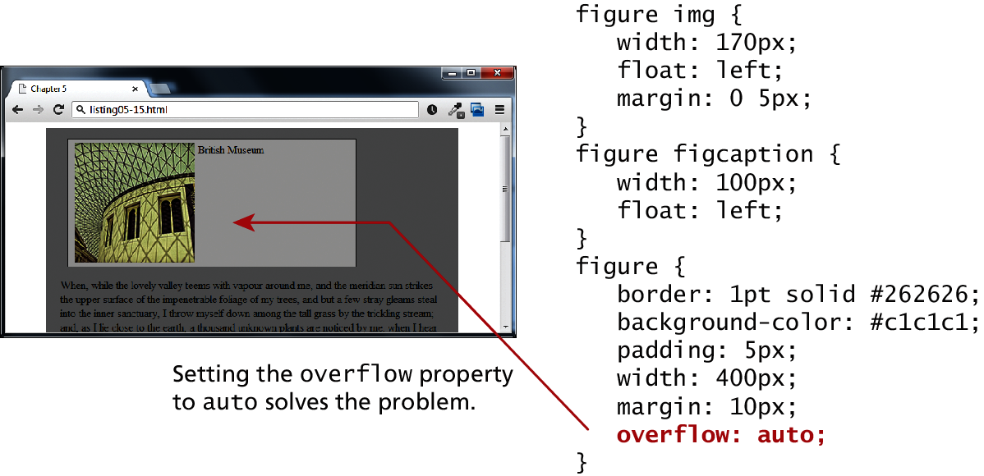
Containing Floats
Solution
One solution would be to float the container as well, but depending on the layout this might not be possible. A better solution would be to use the overflow property

Slide 36
Overlaying and Hiding Elements
One of the more common design tasks with CSS is to place two elements on top of each other, or to selectively hide and display elements. Positioning is important to both of these tasks.
Positioning is often used for smaller design changes, such as moving items relative to other elements within a container
In such a case, relative positioning is used to create the positioning context for a subsequent absolute positioning move

Slide 37
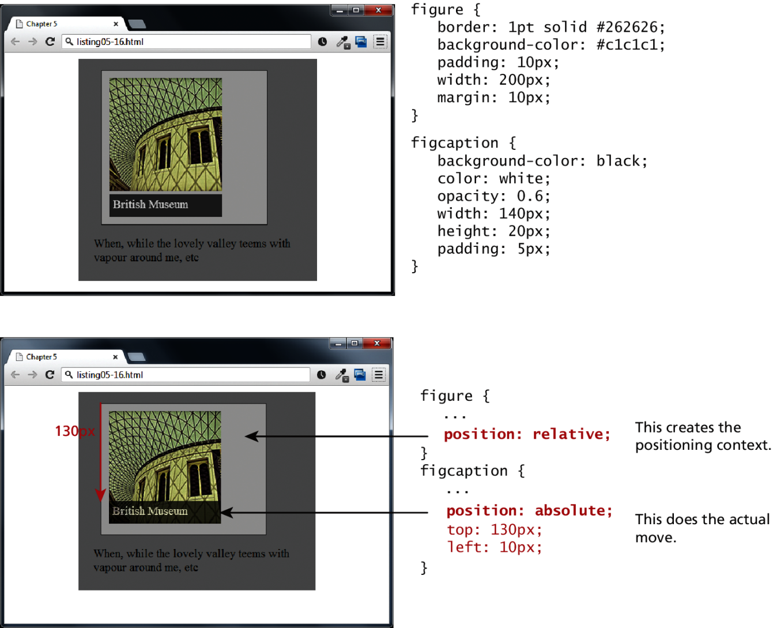
Positioning Context
A Helpful thing to learn

Slide 38
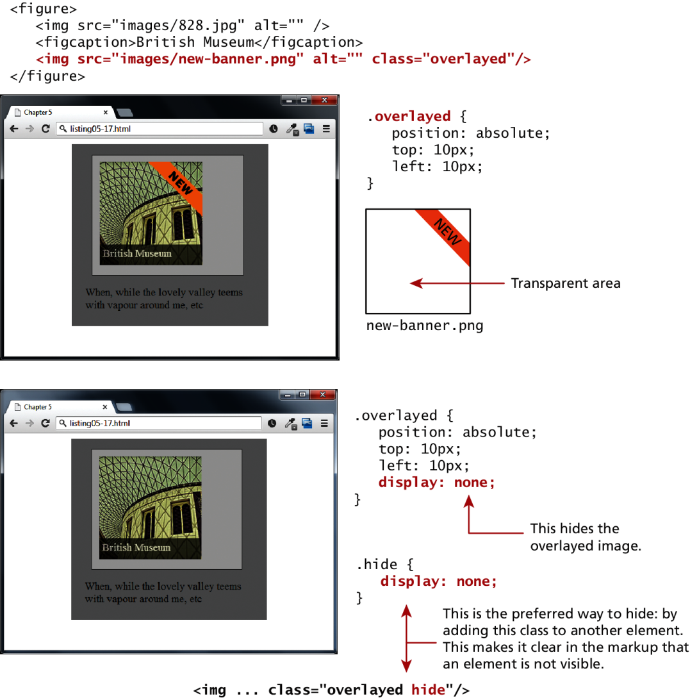
Positioning Context
A realistic example

Slide 39
Hiding elements
Two different ways to hide elements in CSS:
using the display property
The display property takes an item out of the flow: it is as if the element no longer exists
using the visibility property
The visibility property just hides the element, but the space for that element remains.

Slide 40
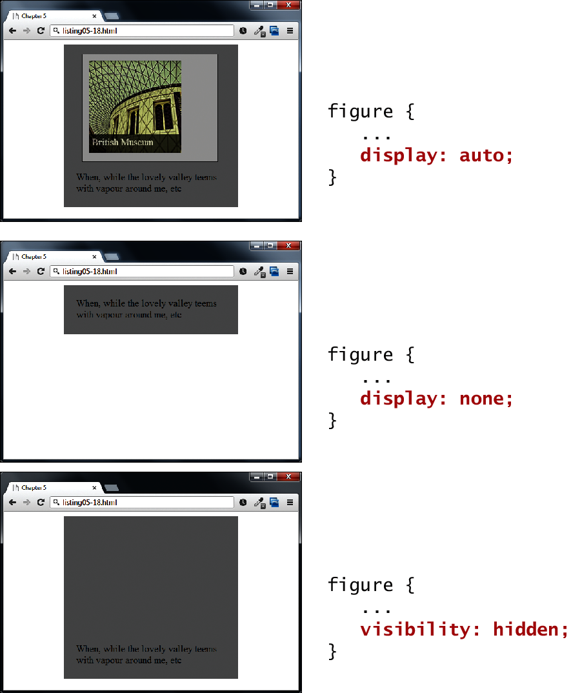
Hiding elements
Two ways to hide: display and visibility

Slide 41
Using :hover to make thumbnails
Next slide shows how the combination of absolute positioning, the :hover pseudo-class, and the visibility property can be used to display a larger version of an image

Slide 42
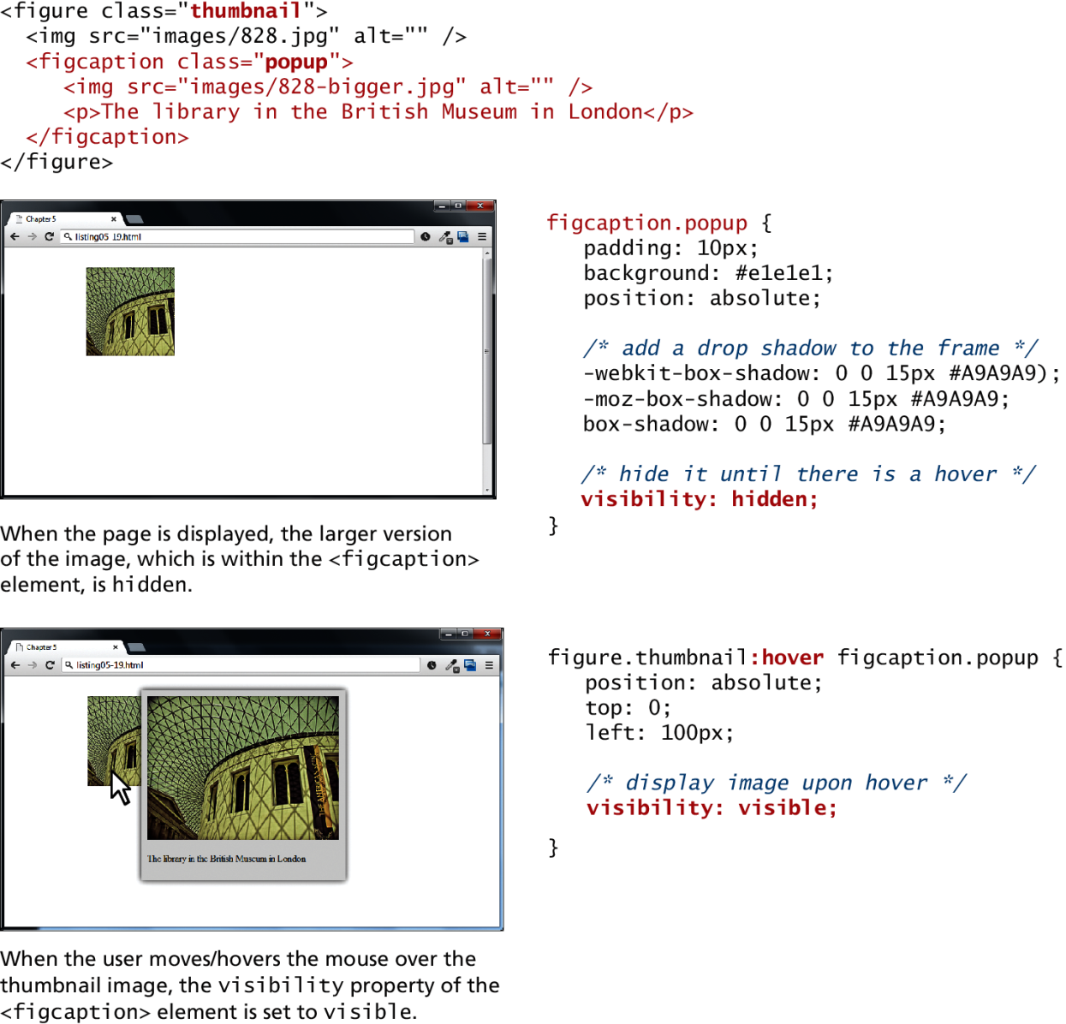
Using :hover to make thumbnails

Slide 43
Constructing Multicolumn Layouts
Section 4 of 7

Slide 44
Constructing Multicolumn Layouts
There is unfortunately no simple and easy way to create robust multicolumn page layouts. There are tradeoffs with each approach:
Using Floats to Create Columns
Using Positioning to Create Columns

Slide 45
Using Floats to create Columns
The most common way to create columns of content is using floats.
The first step is to float the content container that will be on the left-hand side. Remember that the floated container needs to have a width specified.

Slide 46
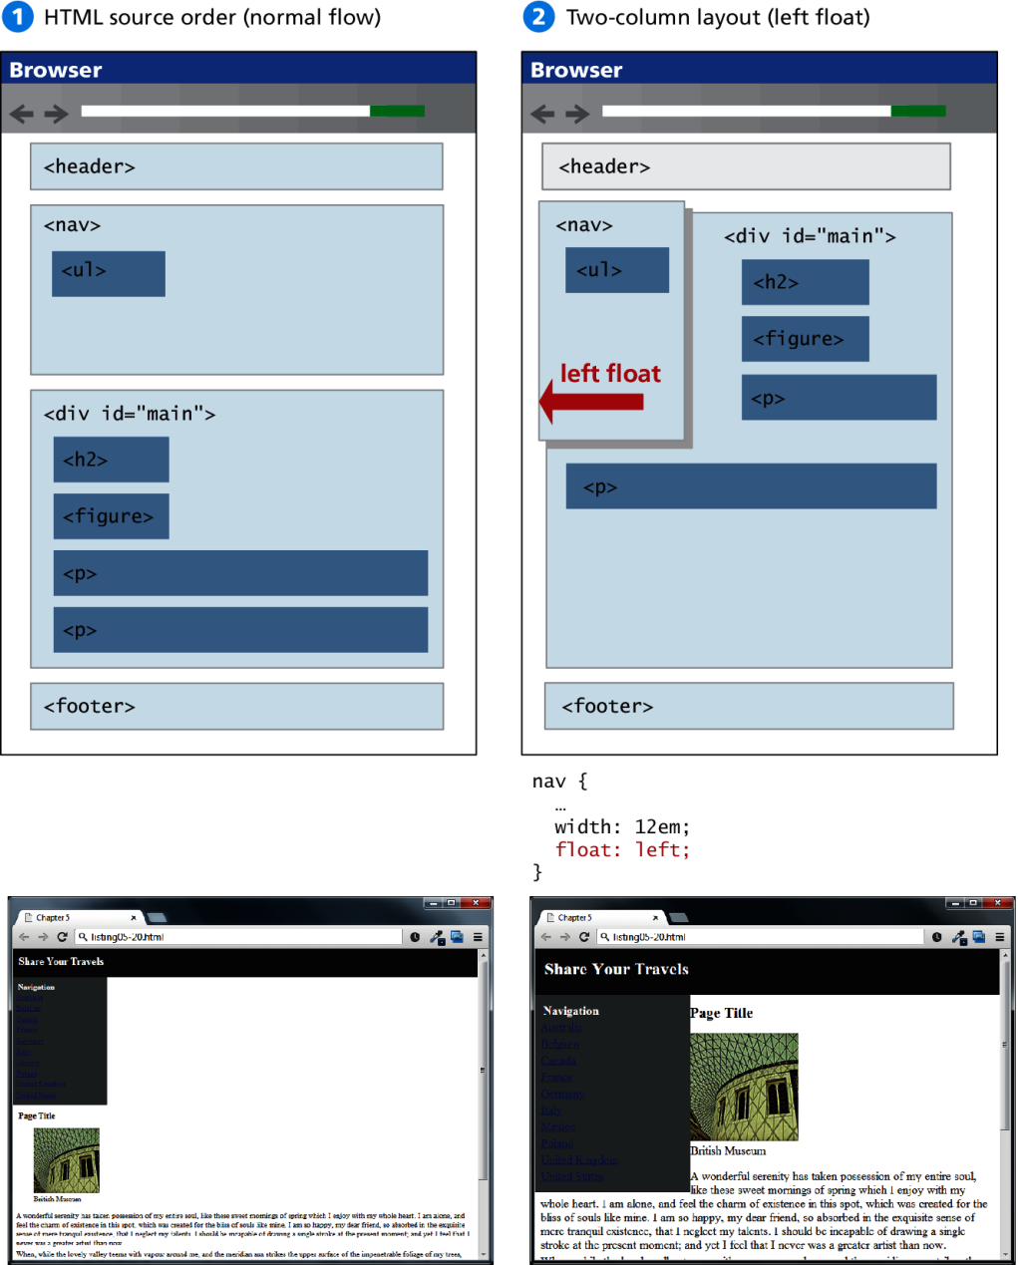
Using Floats to create Columns

Slide 47
Using Floats to create Columns
The other key step is changing the left-margin so that it no longer flows back under the floated content.

Slide 48
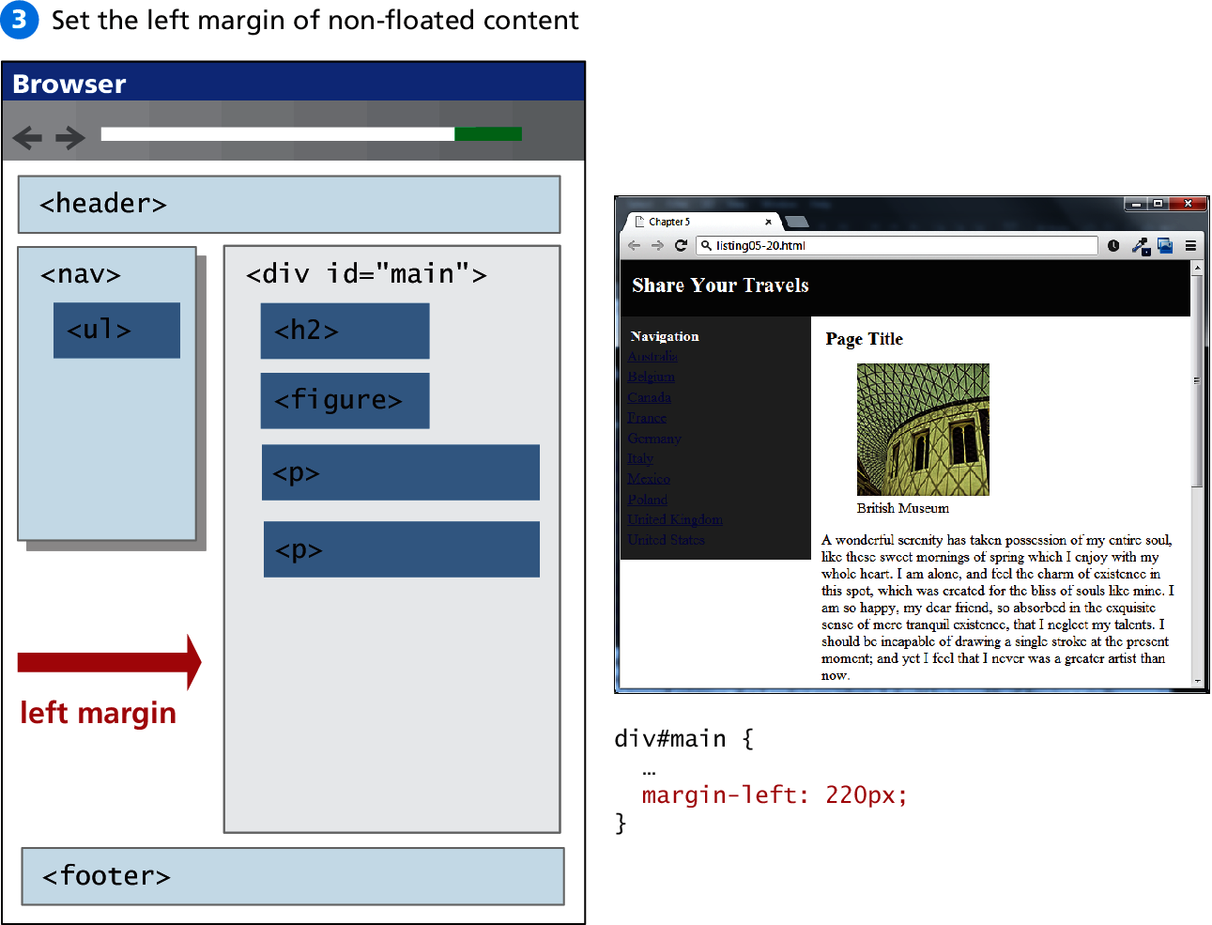
Using Floats to create Columns

Slide 49
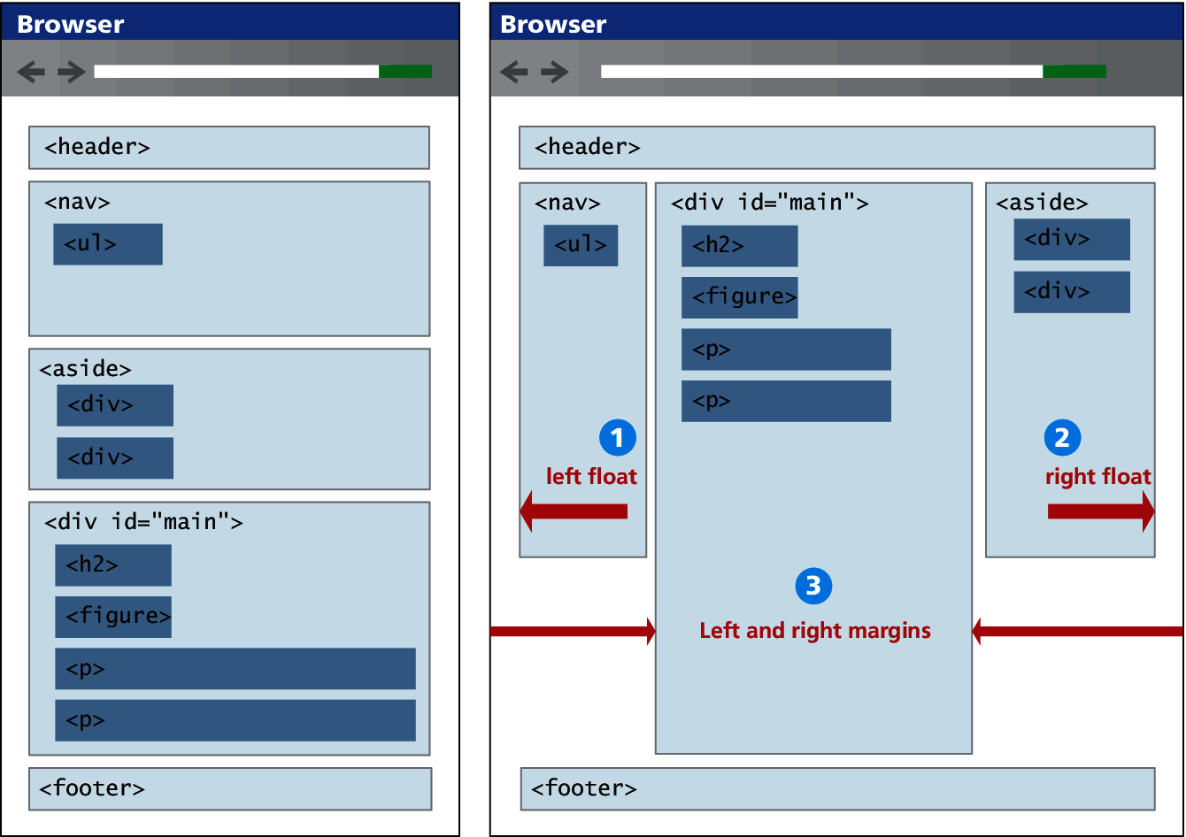
Using Floats for Columns
3 Column Example

Slide 50
Using Positioning to Create Columns
Positioning can also be used to create a multicolumn layout. Typically, the approach will be to absolute position the elements that were floated in the examples from the previous section

Slide 51
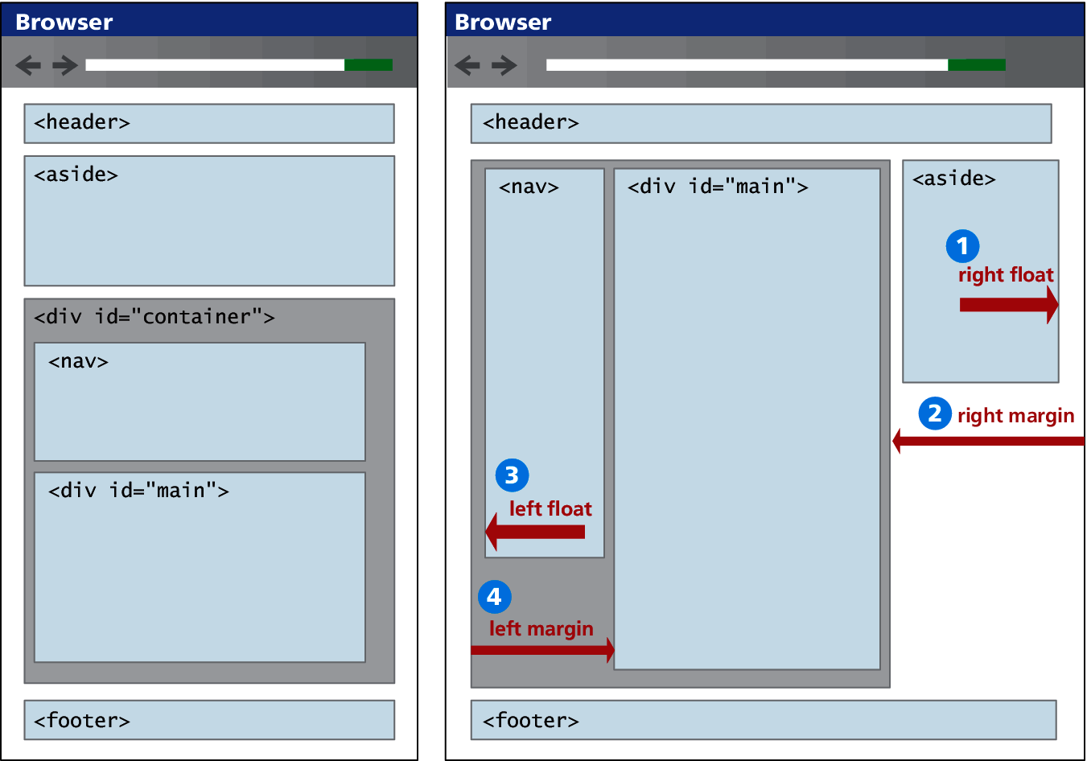
Using Positioning to Create Columns

Slide 52
Positioning discussion
Positives
Notice that with positioning it is easier to construct our source document with content in a more SEO-friendly manner; in this case, the main <div> can be placed first.

Slide 53
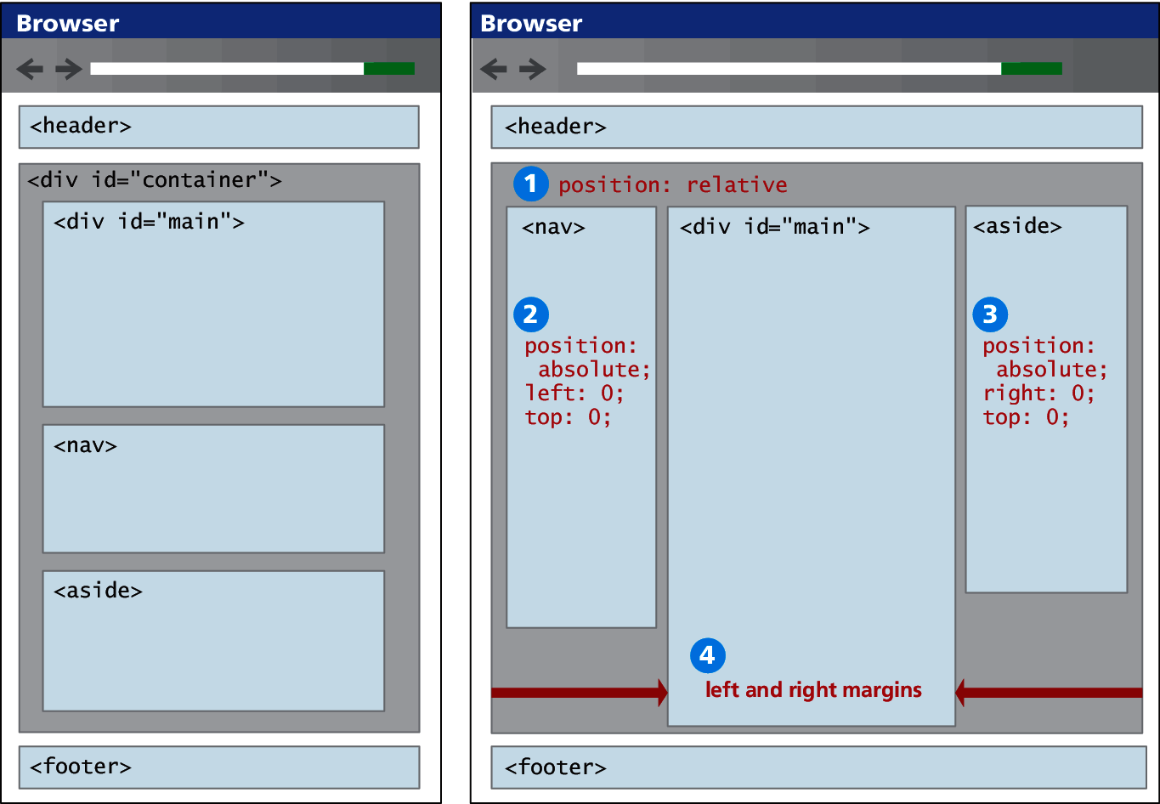
Positioning discussion
Positives

Slide 54
Positioning discussion
Challenges
What would happen if one of the sidebars had a lot of content and was thus quite long?
In the floated layout, this would not be a problem at all, because when an item is floated, blank space is left behind.
But when an item is positioned, it is removed entirely from normal flow, so subsequent items will have no “knowledge” of the positioned item.

Slide 55
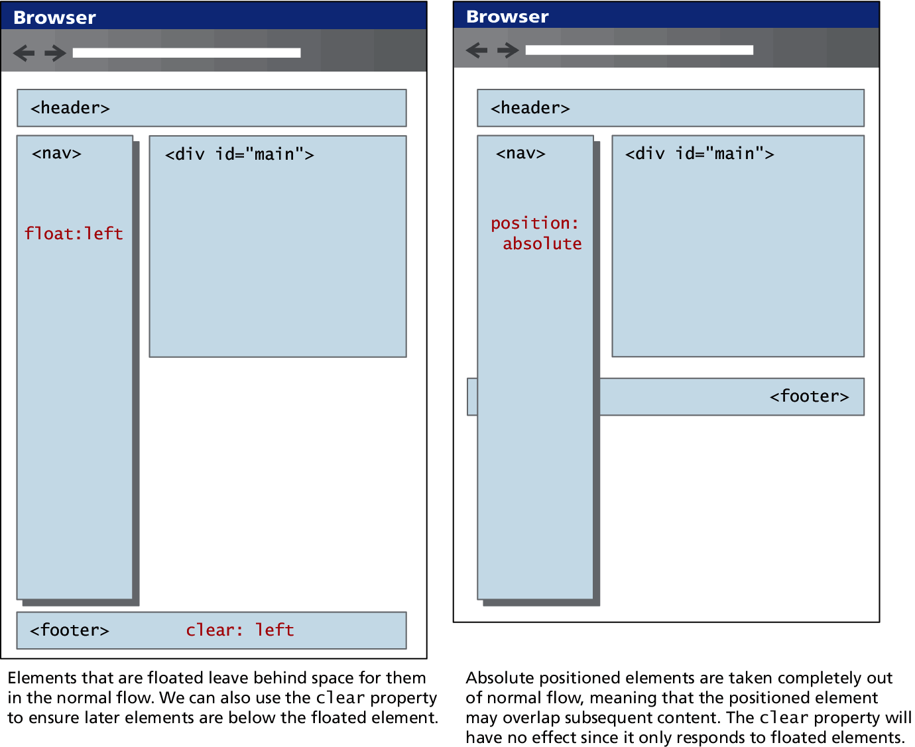
Positioning Discussion
Problem illustration

Slide 56
Approaches to CSS Layout
Section 5 of 7

Slide 57
Approaches to CSS Layout
One of the main problems faced by web designers is that the size of the screen used to view the page can vary quite a bit.
21-inch wide screen monitor that can display 1920x1080 pixels
older iPhone with a 3.5 screen and a resolution of 320x480 px
Satisfying both users can be difficult; the approach to take for one type of site content might not work as well with another site with different content.

Slide 58
Approaches to CSS Layout
Most designers take one of two basic approaches to dealing with the problems of screen size.
Fixed Layout
Liquid Layout
Hybrid Layout

Slide 59
Fixed Layout
It isn't even broken
In a fixed layout, the basic width of the design is set by the designer, typically corresponding to an “ideal” width based on a “typical” monitor resolution
The advantage of a fixed layout is that it is easier to produce and generally has a predictable visual result.
Fixed layouts have drawbacks.
For larger screens, there may be an excessive amount of blank space to the left and/or right of the content.
It is also optimized for typical desktop monitors; however, as more and more user visits are happening via smaller mobile devices

Slide 60
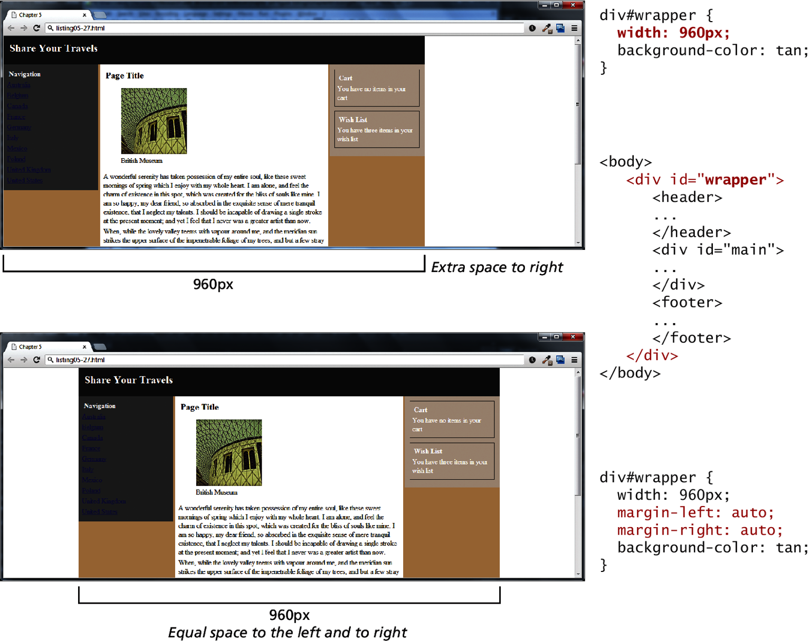
Fixed Layout
Notice the fixed size

Slide 61
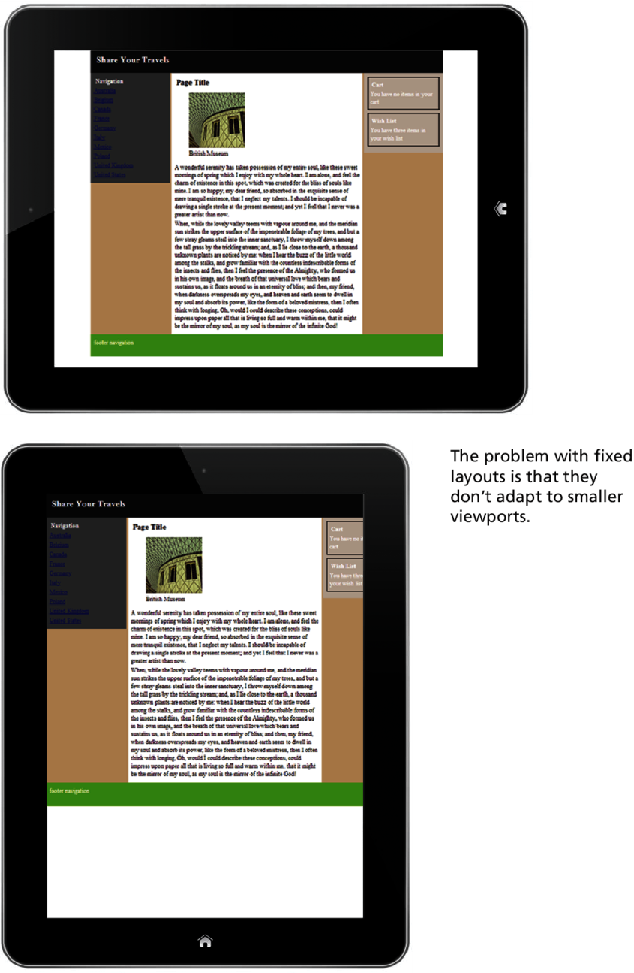
Problem with fixed layouts

Slide 62
Liquid Layout
Liquidy goodness
In a liquid layout (also called a fluid layout) widths are not specified using pixels, but percentage values.
Advantage:
adapts to different browser sizes,
Disadvantages:
Liquid layouts can be more difficult to create because some elements, such as images, have fixed pixel sizes
the line length (which is an important contributing factor to readability) may become too long or too short

Slide 63
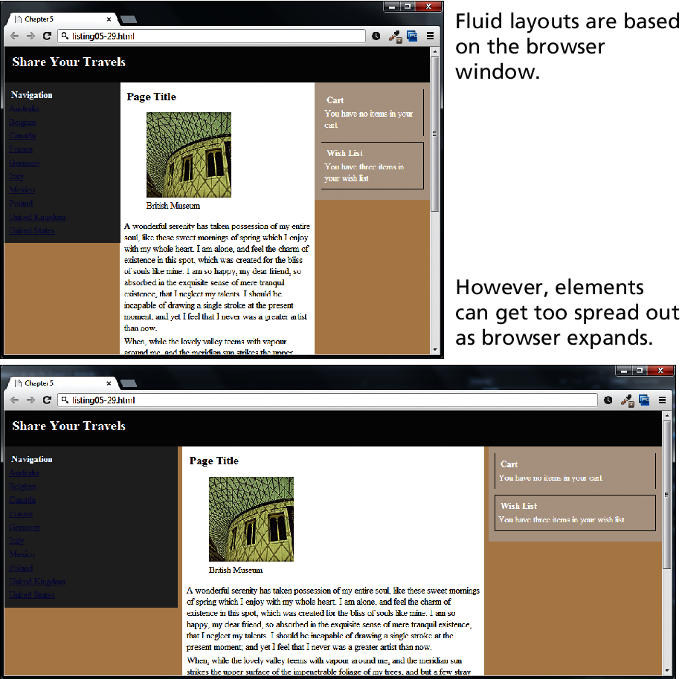
Liquid Layout
Liquidy goodness

Slide 64
Hybrid Layout
Such a smug feeling
A hybrid layout combines pixel and percentage measurements.
Fixed pixel measurements might make sense for a sidebar column containing mainly graphic advertising images that must always be displayed and which always are the same width.
percentages would make more sense for the main content or navigation areas, with perhaps min and max size limits in pixels set for the navigation areas

Slide 65
Responsive Design
Section 6 of 7

Slide 66
Responsive Design
In a responsive design, the page “responds” to changes in the browser size that go beyond the width scaling of a liquid layout.
One of the problems of a liquid layout is that images and horizontal navigation elements tend to take up a fixed size, and when the browser window shrinks to the size of a mobile browser, liquid layouts can become unusable. In a responsive layout, images will be scaled down and navigation elements will be replaced as the browser shrinks,

Slide 67
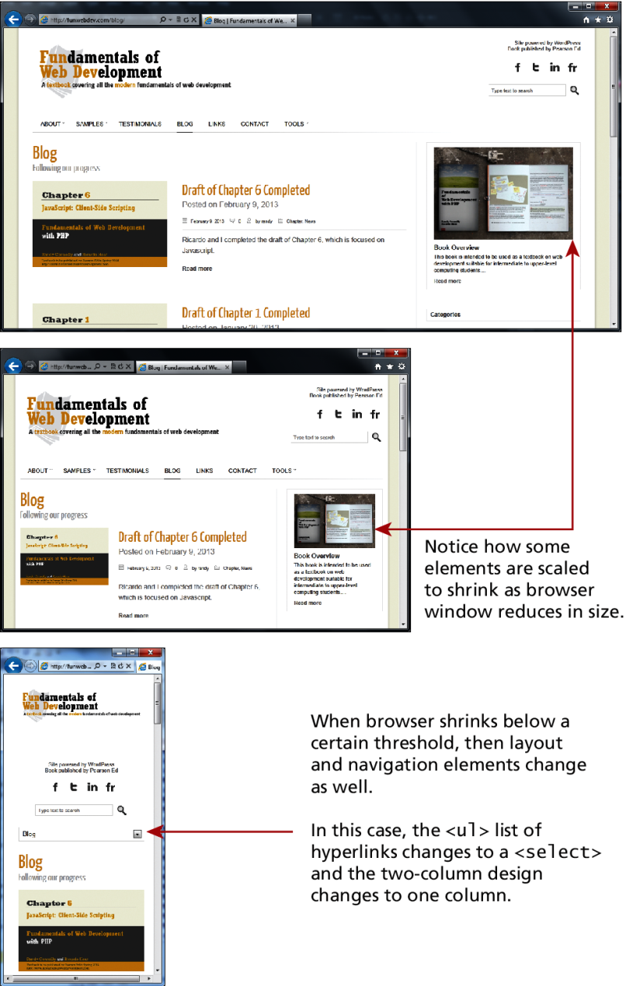
Responsive Design
Example

Slide 68
Responsive Design
Example
There are four key components that make responsive design work.
Liquid layouts
Scaling images to the viewport size
Setting viewports via the <meta> tag
Customizing the CSS for different viewports using media queries

Slide 69
Responsive Design
Liquid Layout
Responsive designs begin with a liquid layout, that is, one in which most elements have their widths specified as percentages. Making images scale in size is actually quite straightforward, in that you simply need to specify the following rule:
img {
max-width: 100%;
}

Slide 70
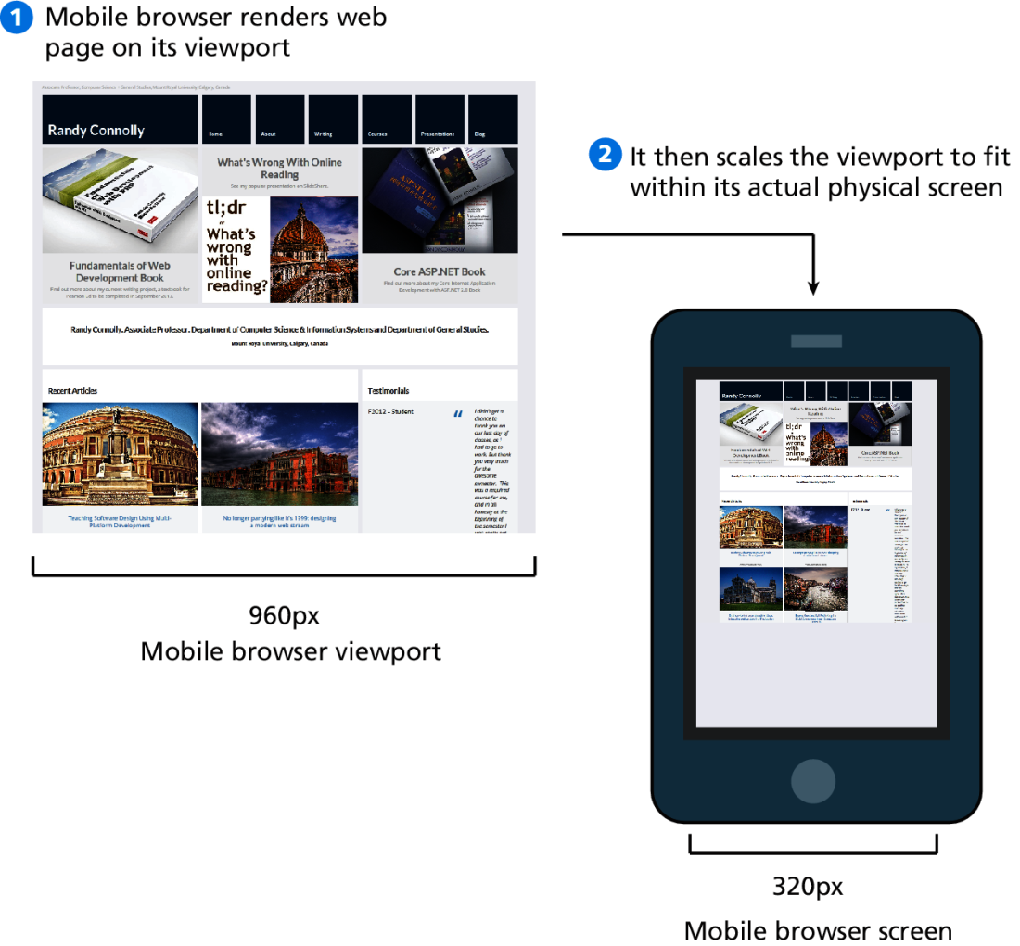
Responsive Design
Setting Viewports
A key technique in creating responsive layouts makes use of the ability of current mobile browsers to shrink or grow the web page to fit the width of the screen.

Slide 71
Responsive Design
Setting Viewports
If the developer has created a responsive site that will scale to fit a smaller screen, she may not want the mobile browser to render it on the full-size viewport. The web page can tell the mobile browser the viewport size to use via the viewport <meta> element
<html>
<head>
<meta name="viewport" content="width=device-width" />

Slide 72
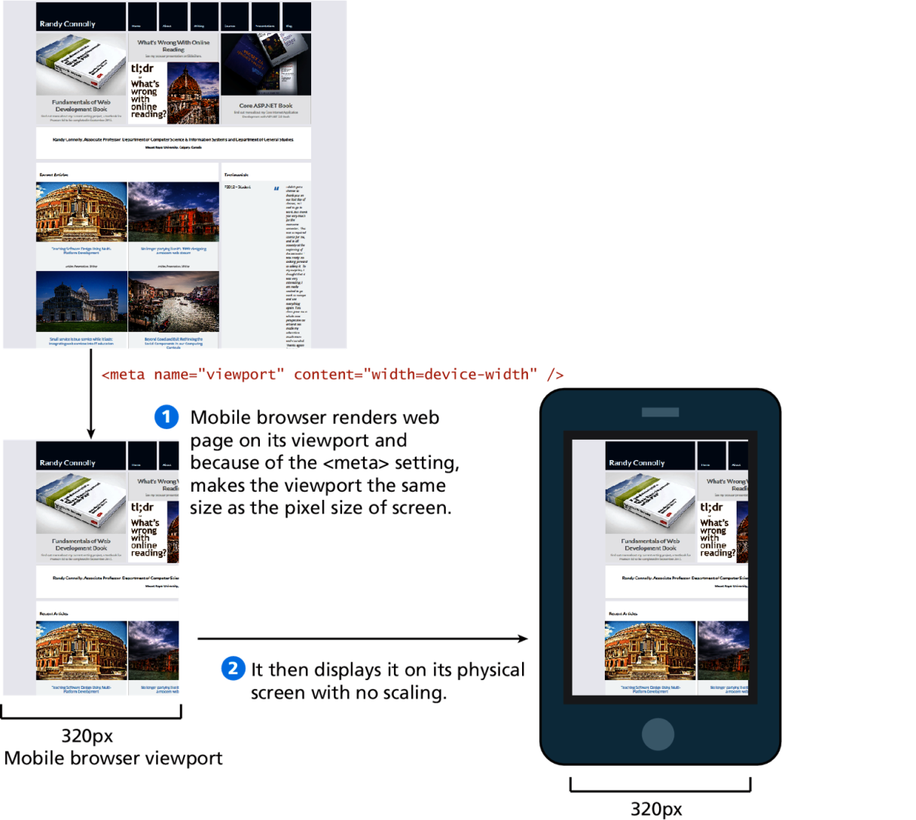
Responsive Design
Setting Viewports

Slide 73
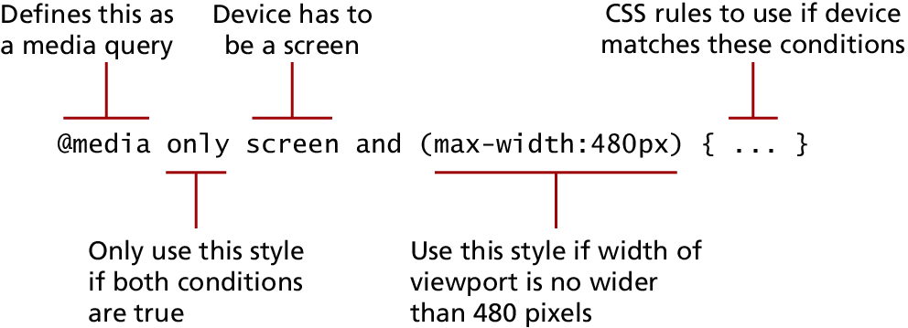
Media Queries
The other key component of responsive designs is CSS media queries. A media query is a way to apply style rules based on the medium that is displaying the file. You can use these queries to look at the capabilities of the device, and then define CSS rules to target that device.

Slide 74
Media Queries
Contemporary responsive sites will typically provide CSS rules for phone displays first, then tablets, then desktop monitors, an approach called progressive enhancement, in which a design is adapted to progressively more advanced devices

Slide 75
Media Queries
[HP1]Au: Should these go in monospace font? HP
Browser features you can Examine with Media Queries
Feature | Description
width | Width of the viewport
height | Height of the viewport
device-width | Width of the device
device-height | Height of the device
orientation | Whether the device is portrait or landscape
color | The number of bits per color

Slide 76
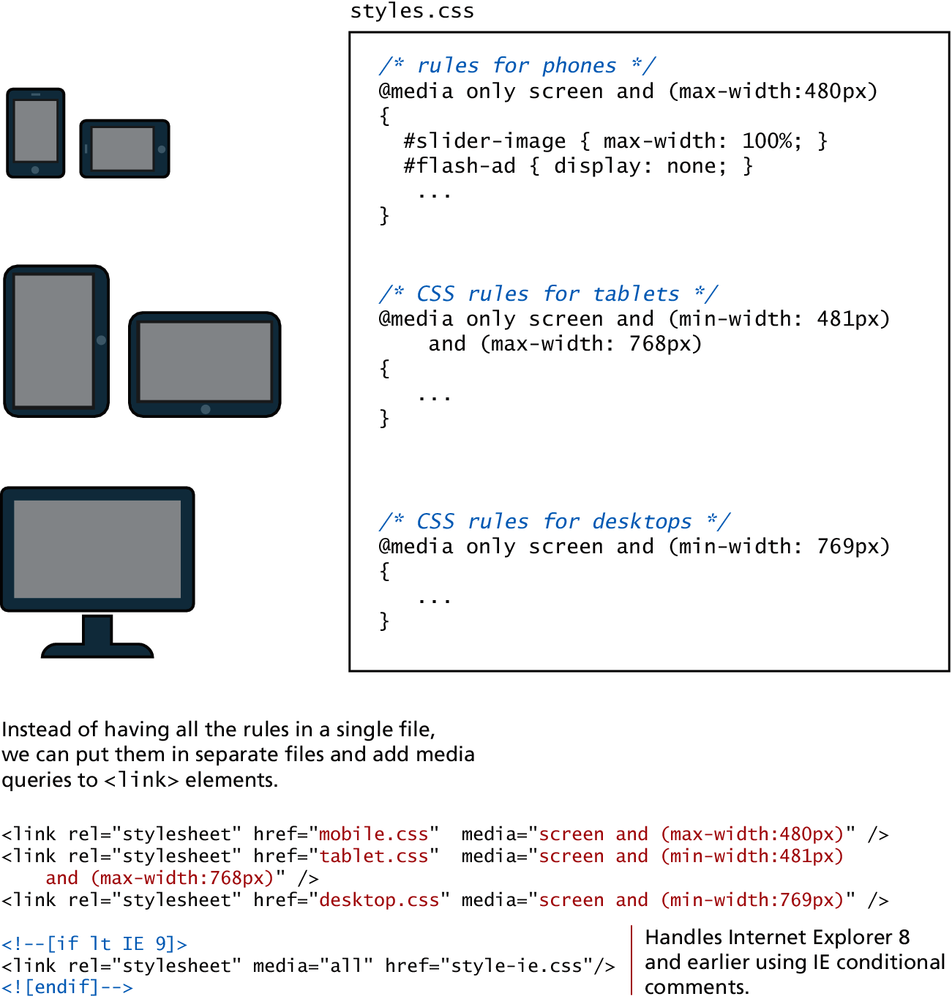
Media Queries
Media queries in action

Slide 77
CSS FramEworks
Section 7 of 7

Slide 78
CSS Frameworks
This is hard!
A CSS framework is a precreated set of CSS classes or other software tools that make it easier to use and work with CSS.
There are two main types of CSS framework:
Grid systems
CSS preprocessors.

Slide 79
Grid Systems
Frameworks do the heavy lifting
Grid systems make it easier to create multicolumn layouts. Some of the most popular are
Bootstrap (twitter.github.com/bootstrap)
Blueprint (www.blueprintcss.org)
960 (960.gs)
Print designers typically use grids as a way to achieve visual uniformity in a design. In print design, the very first thing a designer may do is to construct, for instance, a 5- or 7- or 12-column grid. The rest of the document, whether it be text or graphics, will be aligned and sized according to the grid

Slide 80
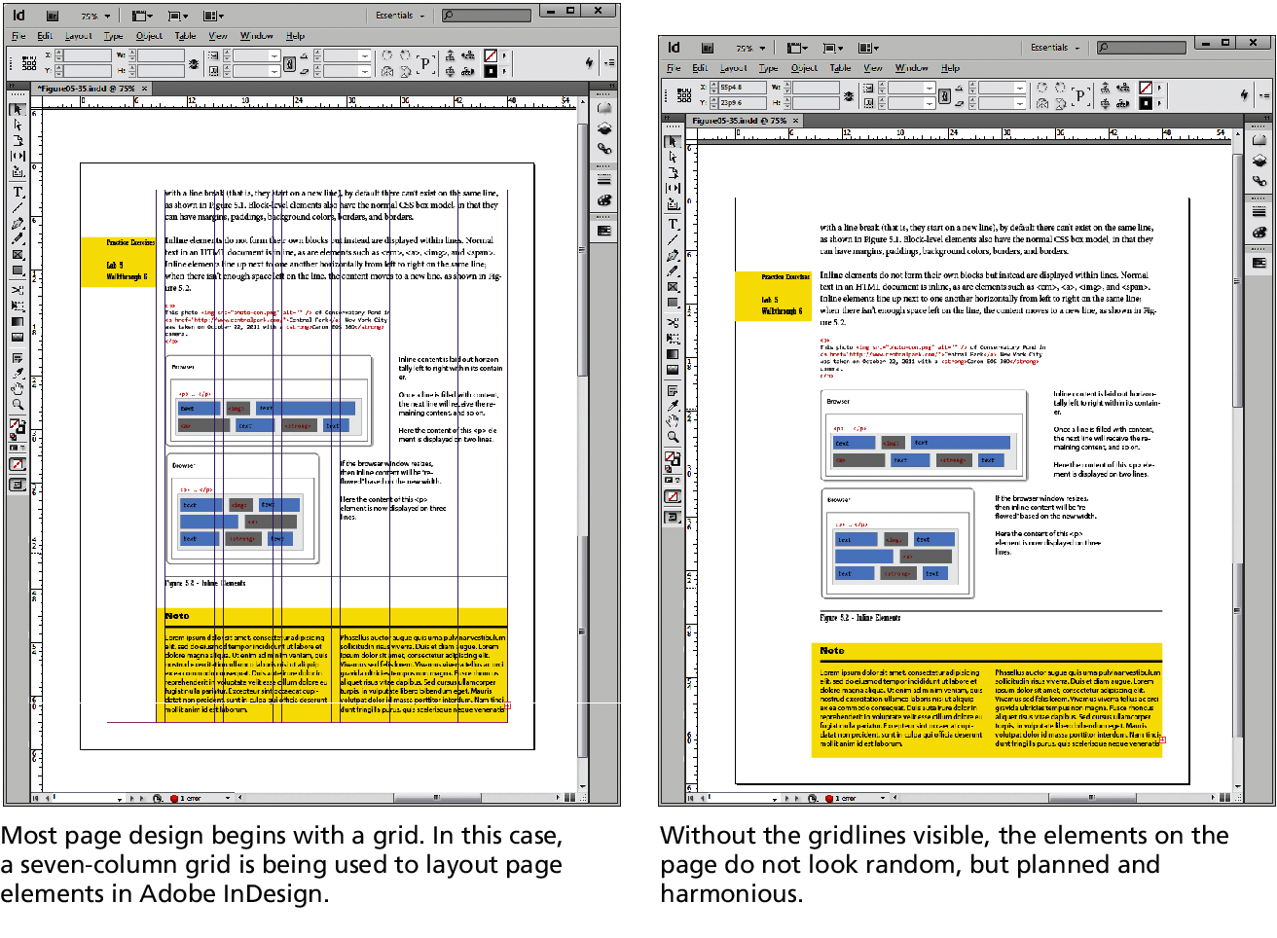
Grid Systems
Frameworks do the heavy lifting

Slide 81
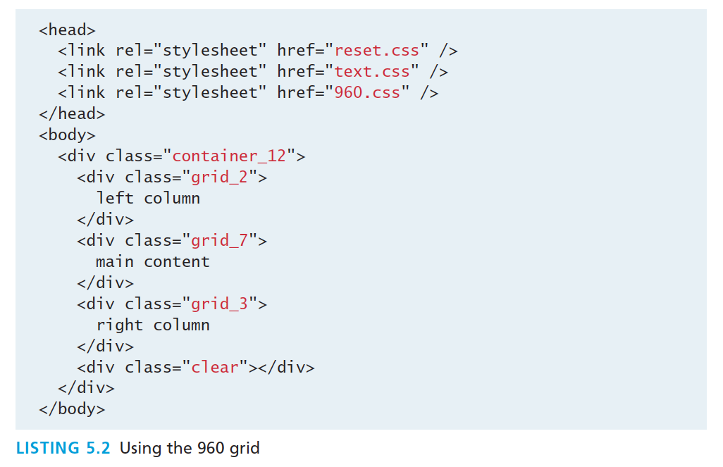
Grid Systems
960 code

Slide 82
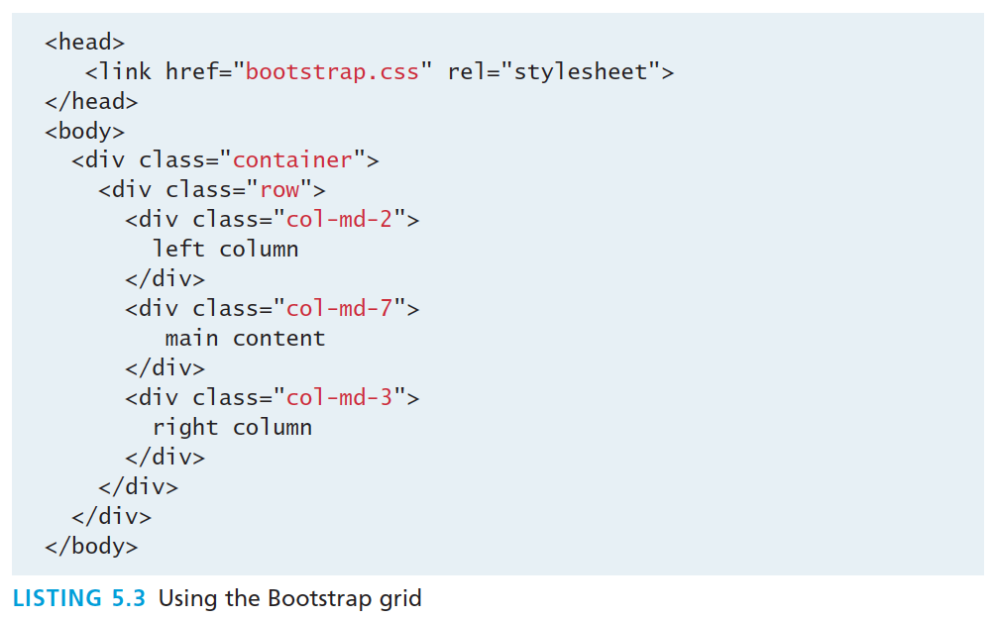
Grid Systems
Bootstrap code

Slide 83
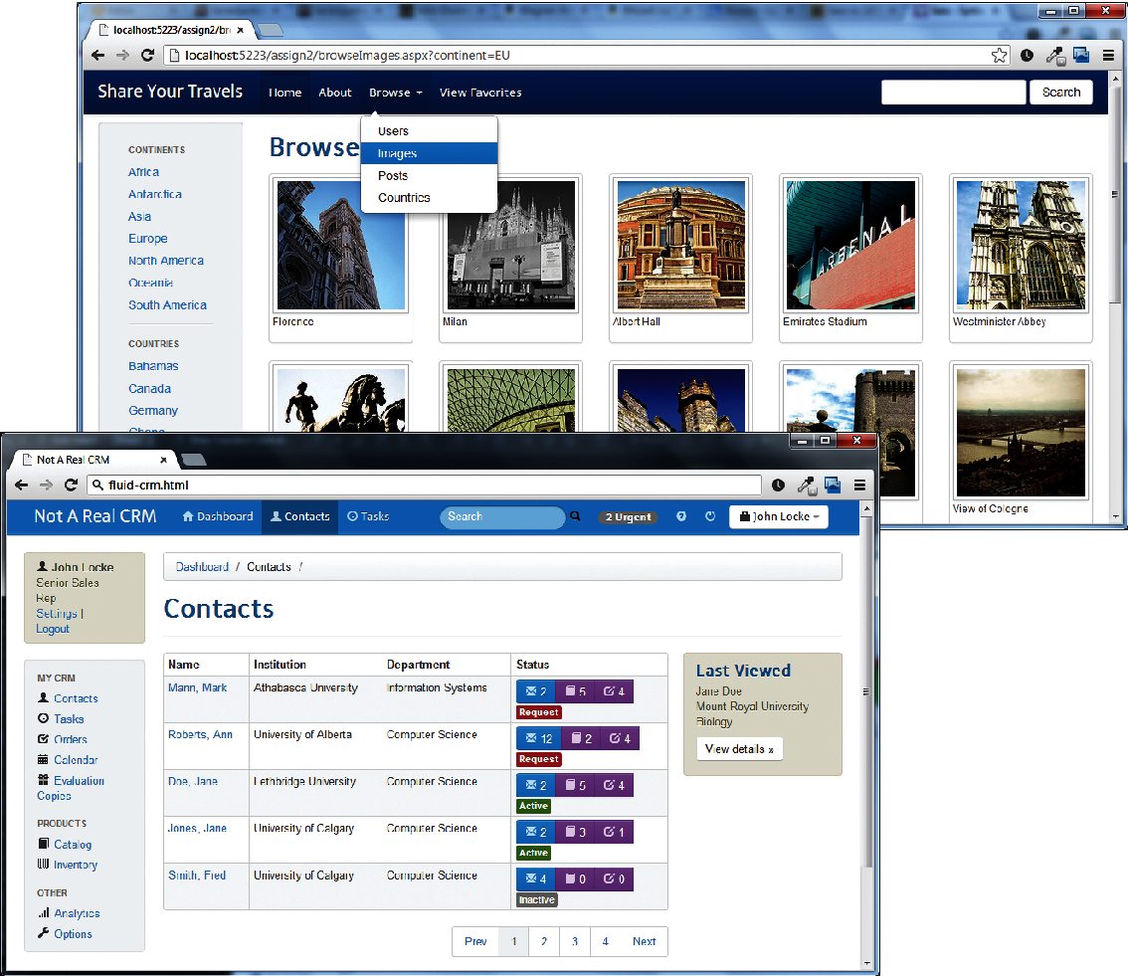
Example Pure Bootstrap Layouts

Slide 84
CSS Preprocessors
CSS preprocessors are tools that allow the developer to write CSS that takes advantage of programming ideas such as variables, inheritance, calculations, and functions.
Most sites make use of some type of color scheme, perhaps four or five colors. Many items will have the same color.

Slide 85
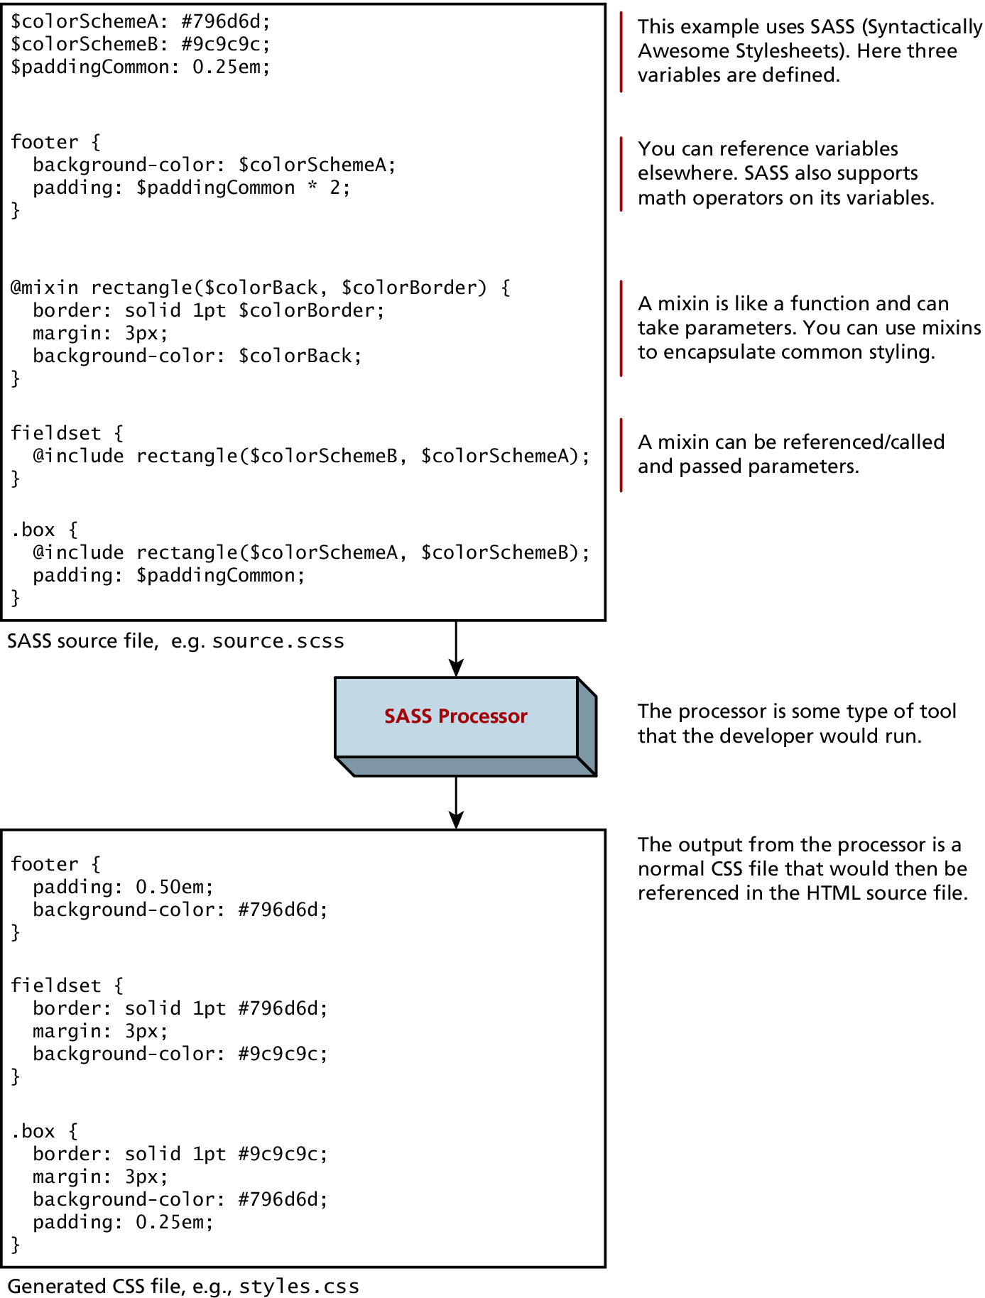
CSS Preprocessors

Slide 86
What you Learned
1
2
Normal Flow
Positioning
Elements
3
4
Floating Elements
Multicolumn Layouts
5
6
Approaches to CSS Layout
Responsive Design
7
7
CSS Frameworks

